Slide 1
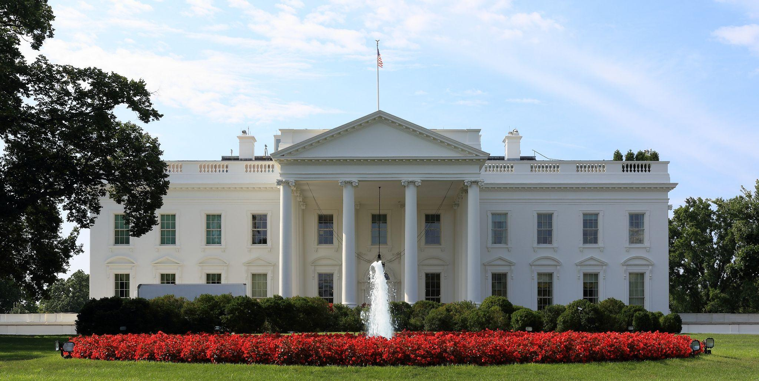
What if Personal Finance and Fiscal Policy Were the Same?
A Financial Perspective of our US Presidents’ Investment Returns in America… History’s Look at Personal Finance.
January 24, 2023
5:30-6:00 Dinner
6:00-7:00 Workshop
7:00 Short Break
7:10 Resume Workshop
8:15 Wrap Up and Close

Slide 2
Your Presenters:
Breann
Schab
Teacher, 12 years
Fusion Global Academy
Brittany
Sampson
Teacher, 21 years
Lakeland Senior High
Polk County Public Schools
BreannSchab@gmail.com Bsampson@usf.edu

Slide 3
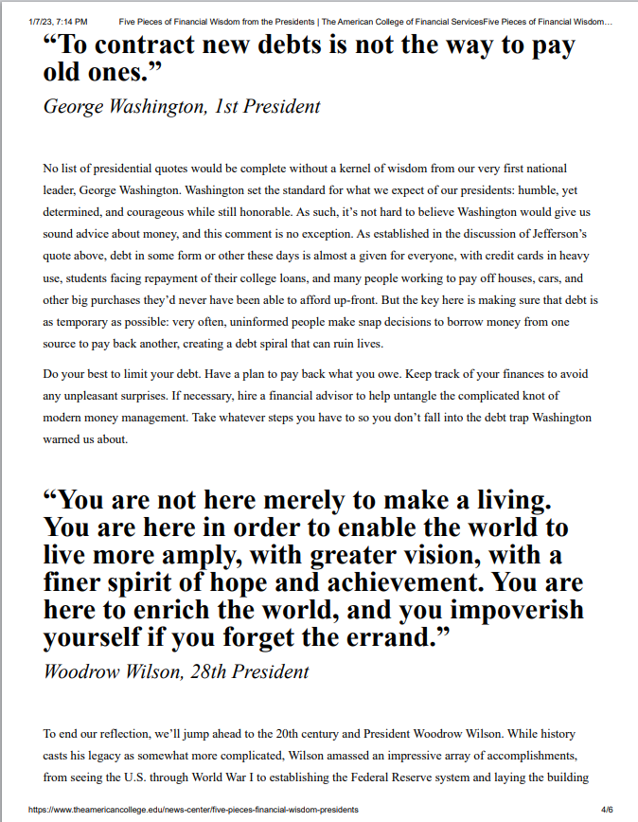
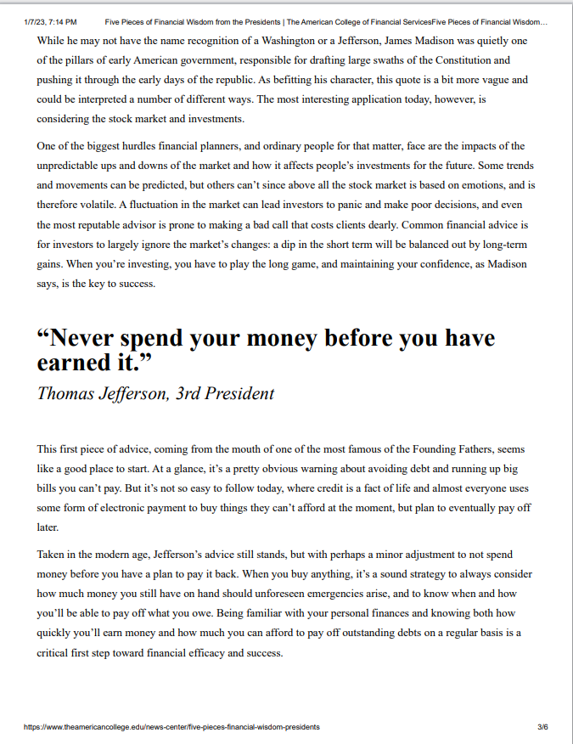
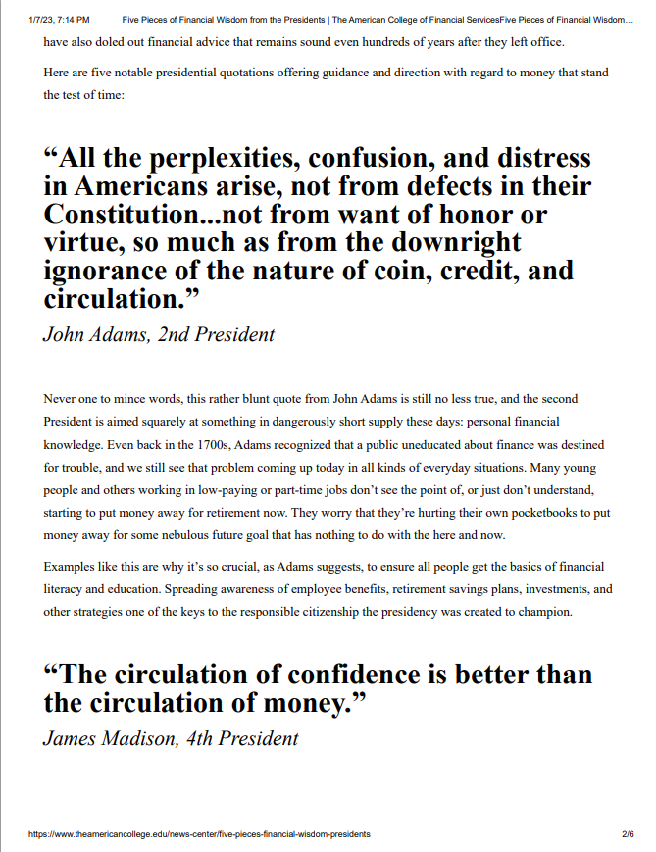
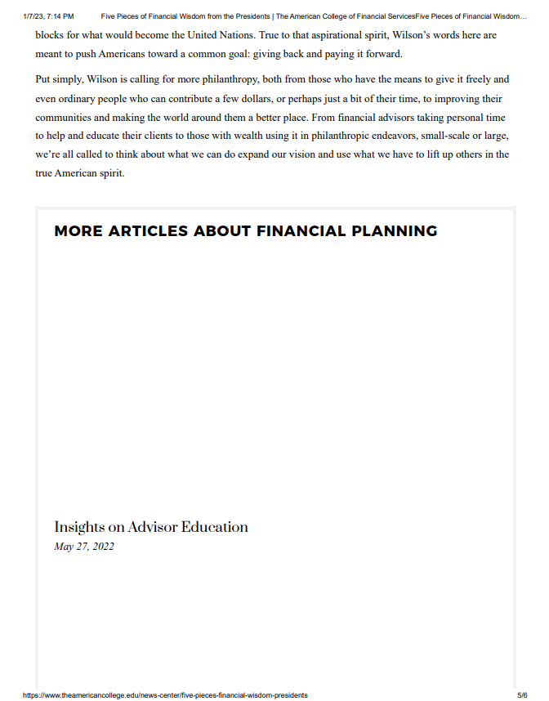
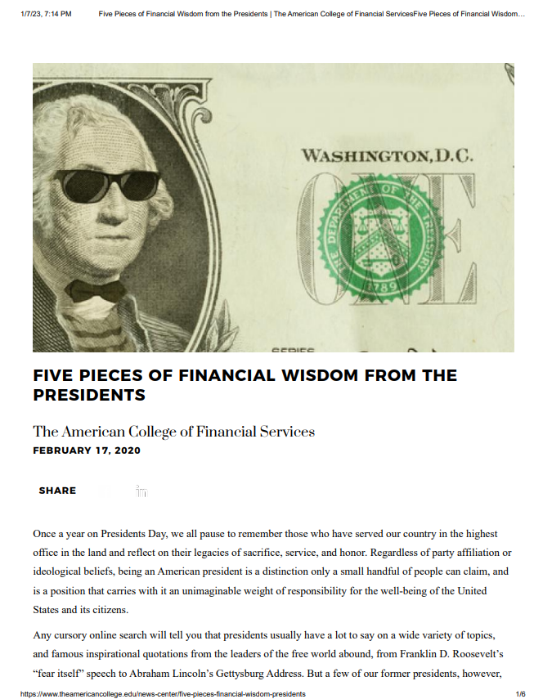
Introductory Article:
FIVE PIECES OF FINANCIAL WISDOM FROM THE PRESIDENTS
https://www.theamericancollege.edu/news-center/five-pieces-financial-wisdom-presidents

Slide 4
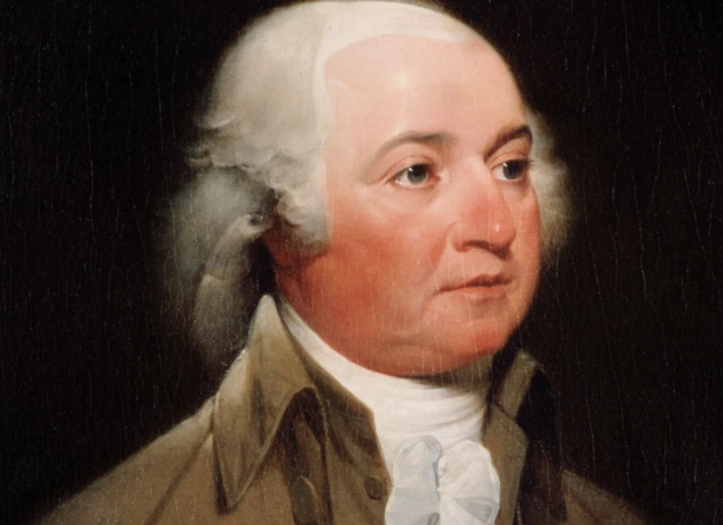
John Adams
2nd President of the White House
(1797-1801) Federalist Party
Born 1735
Founding Father
VP to President George Washington
2nd President of the United States
VP: Thomas Jefferson,
“Father of the American Navy”
Established the Library of Congress
Signed the Alien and Sedition Acts
Appointed John Marshall to the US Supreme Court
Died 1826, 90 years

Slide 5
“All the perplexities, confusion, and distress in Americans arise, not from defects in their Constitution...not from want of honor or virtue, so much as from the downright ignorance of the nature of coin, credit, and circulation.”
John Adams, 2nd President

Slide 6
John Adams
Even back in the 1700s, Adams recognized that a public uneducated about finance was destined for trouble, and we still see that problem coming up today in all kinds of everyday situations. Many young people and others working in low-paying or part-time jobs don’t see the point of, or just don’t understand, starting to put money away for retirement now. They worry that they’re hurting their own pocketbooks to put money away for some nebulous future goal that has nothing to do with the here and now.
Spreading awareness of employee benefits, retirement savings plans, investments, and other strategies one of the keys to the responsible citizenship the presidency was created to champion.

Slide 7
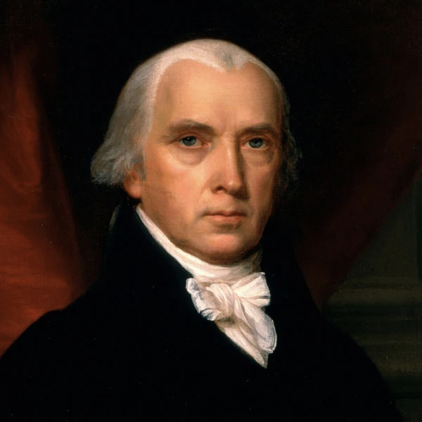
James Madison
4th President of the White House
(1809-1817) Democratic- Republican Party
Born 1751
Founding Father
“Father of the Constitution”
US Secretary of State (5th)
Marbury v. Madison
4th President of the United States
War of 1812, “Era of Good Feelings”
VP:(1809-1812) George Clinton, (1812-1813) vacant, (1813-1814) Elbridge Gerry, vacant (1814-1817)
Died 1836, 85 years

Slide 8
“The circulation of confidence is better than the circulation of money.”
James Madison, 4th President

Slide 9
James Madison
The most interesting application today (for confidence), however, is considering the stock market and investments.
One of the biggest hurdles financial planners, and ordinary people for that matter, face are the impacts of the unpredictable ups and downs of the market and how it affects people’s investments for the future.
Some trends and movements can be predicted, but others can’t since above all the stock market is based on emotions, and is therefore volatile. A fluctuation in the market can lead investors to panic and make poor decisions, and even the most reputable advisor is prone to making a bad call that costs clients dearly. Common financial advice is for investors to largely ignore the market’s changes: a dip in the short term will be balanced out by long-term gains. When you’re investing, you have to play the long game, and maintaining your confidence, as Madison says, is the key to success.

Slide 10
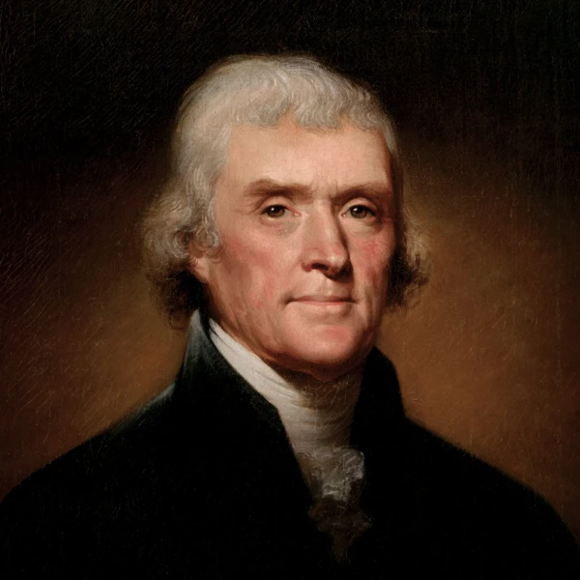
Thomas Jefferson
3rd President of the White House
(1801-1809) Democratic- Republican Party
Born 1743
Founding Father
VP to John Adams
3rd President of the United States
VP: (1801-1805) Aaron Burr, (1805-1809) George Clinton
Louisiana Purchase
Lewis and Clark Expedition (1803-1806)
Attempted annexation of Florida
Founded and Built University of Virginia
Died 1826, 83 years

Slide 11
“Never spend your money before you have earned it.”
Thomas Jefferson, 3rd President

Slide 12
Thomas Jefferson
Being familiar with your personal finances and knowing both how quickly you’ll earn money and how much you can afford to pay off outstanding debts on a regular basis is a critical first step toward financial efficacy and success.

Slide 13
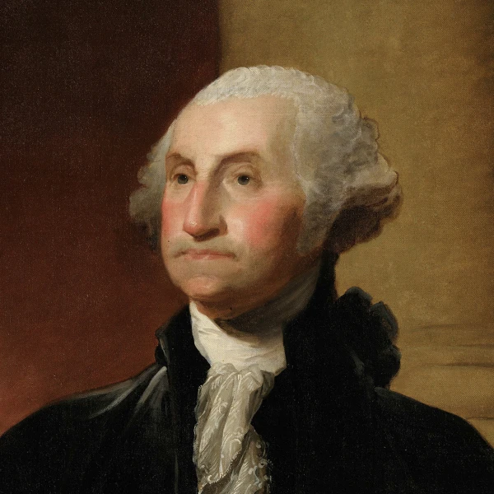
George Washington
1st President of the White House
(1789-1797) Independent
Born 1789
Founding Father
Planter, Military Officer, Surveyor
Commander in Chief of the Continental Army
1st President of the United States
Precedent of “Oath of Office” with his hand on a Bible
VP: John Adams
First National Bank
Whiskey Rebellion
Died 1799, 67 years

Slide 14
“To contract new debts is not the way to pay old ones.”
George Washington, 1st President

Slide 15
George Washington
But the key here is making sure that debt is as temporary as possible: very often, uninformed people make snap decisions to borrow money from one source to pay back another, creating a debt spiral that can ruin lives.
Do your best to limit your debt. Have a plan to pay back what you owe. Keep track of your finances to avoid any unpleasant surprises. If necessary, hire a financial advisor to help untangle the complicated knot of modern money management. Take whatever steps you have to so you don’t fall into the debt trap Washington warned us about.

Slide 16
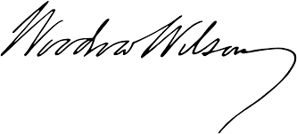
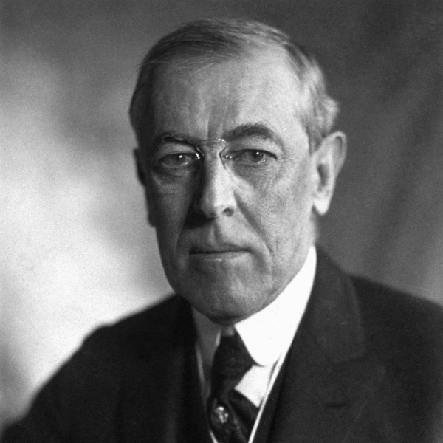
Woodrow Wilson
28th President of the White House
(1913-1921) Democratic Party
Born 1856
28th President of the United States
Women's Suffrage Procession
Federal Reserve Act
Clayton Antitrust Act
18th Amendment, Prohibition
19th Amendment, Votes for Women
Zimmerman Telegram
Entrance into World War 1
Espionage Act, Fourteen Points
Treaty of Versailles
Died 1924, 67 years

Slide 17
“You are not here merely to make a living. You are here in order to enable the world to live more amply, with greater vision, with a finer spirit of hope and achievement. You are here to enrich the world, and you impoverish yourself if you forget the errand.”
Woodrow Wilson, 28th President

Slide 18
Woodrow Wilson
Put simply, Wilson is calling for more philanthropy, both from those who have the means to give it freely and even ordinary people who can contribute a few dollars, or perhaps just a bit of their time, to improving their communities and making the world around them a better place. From financial advisors taking personal time to help and educate their clients to those with wealth using it in philanthropic endeavors, small-scale or large, we’re all called to think about what we can do expand our vision and use what we have to lift up others in the true American spirit.

Slide 19
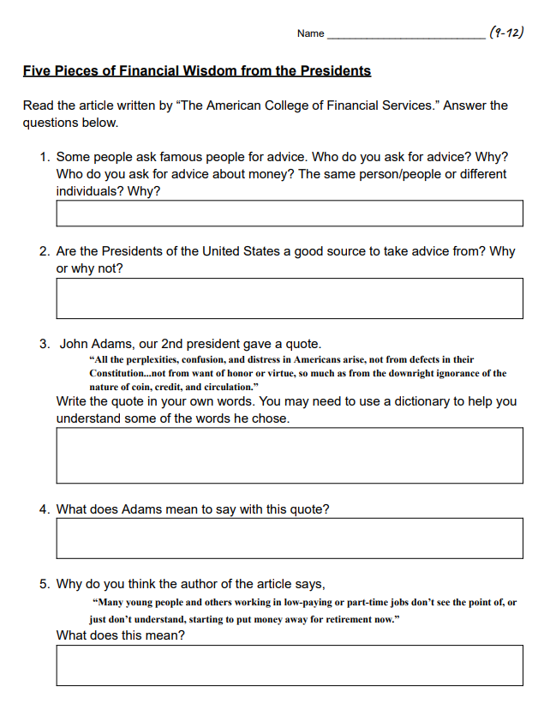
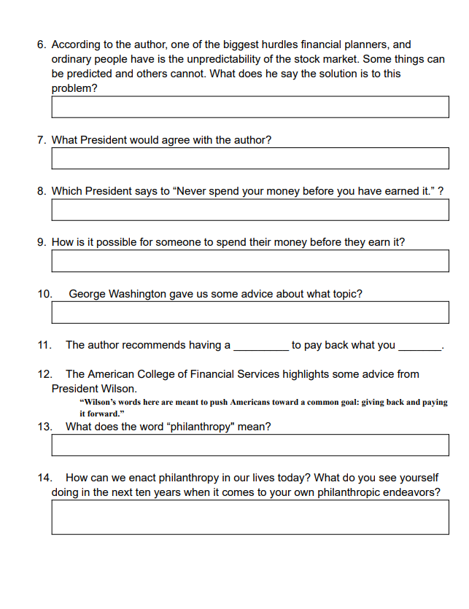
Student Comprehension:
https://www.theamericancollege.edu/news-center/five-pieces-financial-wisdom-presidents
Student Worksheet Google Doc: https://docs.google.com/document/d/10njigRT6OnSvzfzBKDY7pnaHhooYX6TcJGCwzLLdZ-Y/edit?usp=sharing

Slide 20
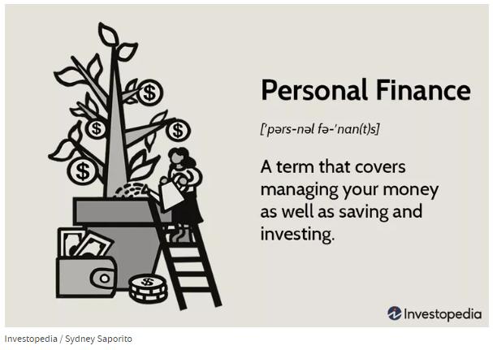
What is the difference between
Fiscal Policy and Personal Finance?

Slide 21
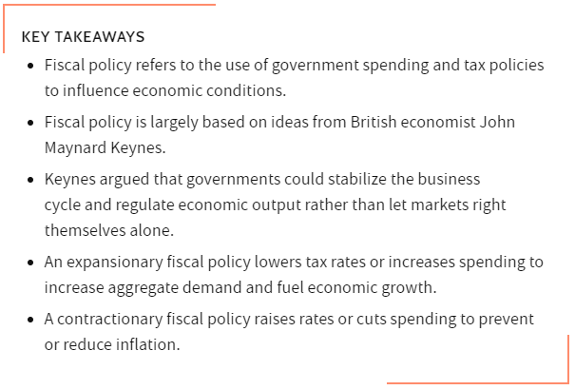
Fiscal Policy
Fiscal Policy Example
During the Great Depression of the 1930s, U.S. unemployment rose to 25% and millions stood in bread lines for food. The misery seemed endless. President Franklin D. Roosevelt decided to put an expansionary fiscal policy to work. He launched his New Deal soon after taking office. It created new government agencies, the WPA jobs program, and the Social Security program, which exists to this day. These spending efforts, combined with his continued expansionary policy spending during World War II, pulled the country out of the Depression.
https://www.investopedia.com/terms/f/fiscalpolicy.asp

Slide 22
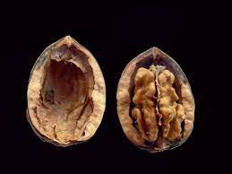
Fiscal Policy in a Nutshell:
Fiscal Policy
The United States is experiencing a tough time.
The US government wants to solve the problem.
Fiscal Policy
Problem: | Looks like: (typically) | Government Solution: | Short Term Result: | Long Term Consequences:
Recession (money not circulating / too little money) | Low prices, Drop in growth/ production, GDP falls, Businesses cannot hire, Unemployment rises, People cannot pay bills/ spend less, Businesses continue to shrink and lay off employees | Tax | People have MORE money to spend, Business hire/ produce Unemployment drops GDP rises | - Consumer spending “>” Production = ACCELERATING INFLATION - Rising interest rates - Crowding out - Increasing trade deficits - ( Imports > Exports )
 |  | Spend
Inflation (money quickly circulating / too much money) | More money in circulation, Prices rise quickly because production cannot keep up with demand, Businesses gain revenue, Businesses continue spending and invest in additional capital (machinery/ technology/ equipment), Businesses able to hire more workers, Unemployment falls, People cannot afford luxury items → (Prices rise faster than incomes) “sticky wages” | Tax | People have LESS money to spend, Business layoff/ cut back investing Unemployment rises GDP slows Prices FALL | - Consumer spending “<” Production = RECESSION/ High Unemployment - Lower interest rates - Depreciation of the dollar - Decrease trade deficit → Americans slow importing and export more. - (or create a trade surplus) : Exporting > Imports
 |  | Spend
Expansionary
Contractionary

Slide 23
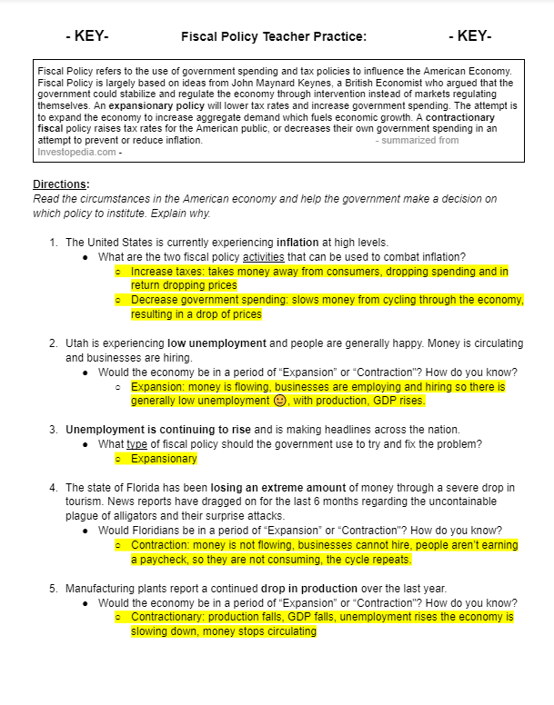
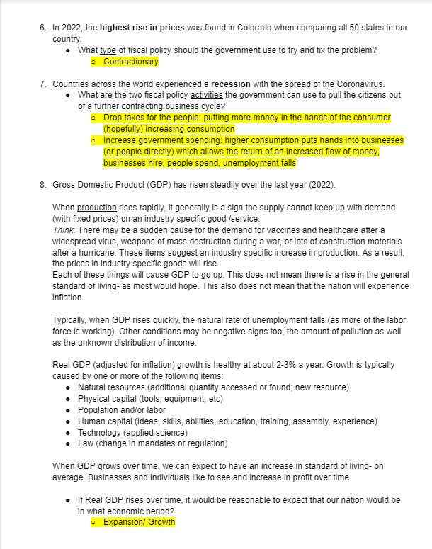
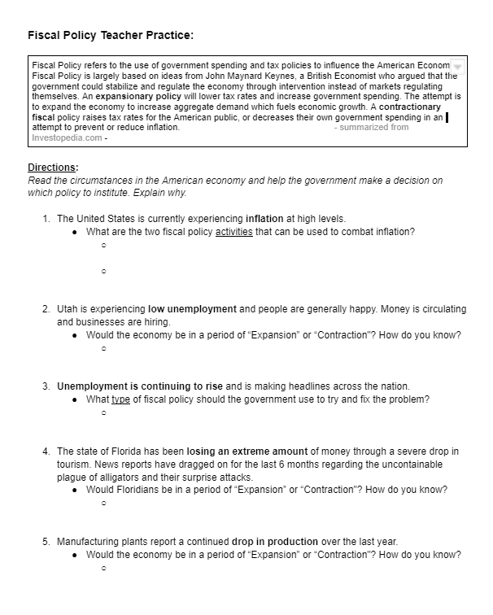
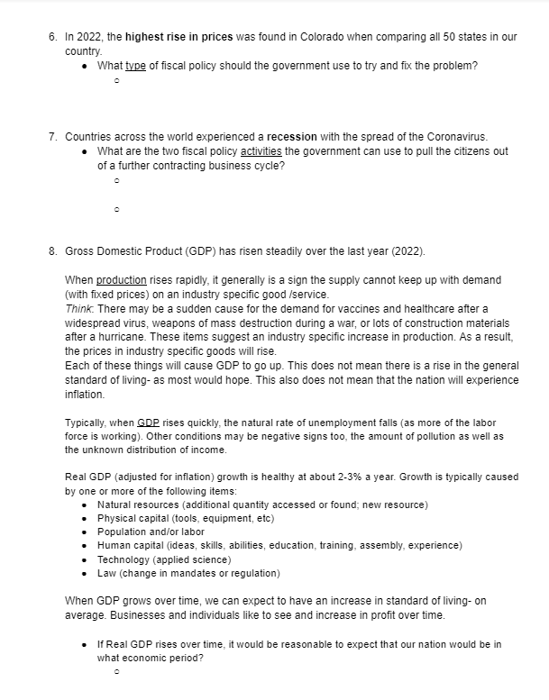
Teacher Practice…
https://docs.google.com/document/d/1FqGsT9Ik9mMjle0UB6CVxfpU97Ps3z1SqSmGcJ_ZHT0/edit?usp=sharing
Teacher help on Fiscal Policy: https://sgp.fas.org/crs/misc/R45723.pdf

Slide 24
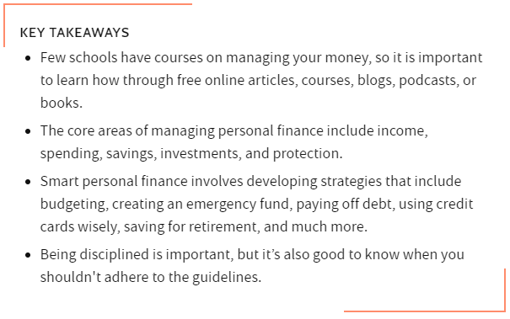
Personal Finance
5 Areas of
Personal Finance
Income
Saving
Spending
Investing
Protection
https://www.investopedia.com/terms/p/personalfinance.asp

Slide 25
Personal Finance STRATEGIES in a Nutshell:
Personal Finance
Personal Finance
Know Your Income
Devise a Budget
Pay Yourself First
Limit and Reduce Debt
Only Borrow What You Can Repay
Monitor Your Credit Score
Plan for Your Future
Buy Insurance
Maximize Your Tax Breaks
Give Yourself A Break
Remember: strategies are techniques for practicing good Personal Finance… they are not ordered in specific steps.

Slide 26
Personal Finance SKILLS
in a Nutshell:
What Personal Finance classes CANNOT teach you:
Personal Finance
Personal Finance
Finance Prioritization
Assessing Costs and Benefits
Restraining Your Spending
Discipline
A Sense of Timing
Emotional Detachment

Slide 27
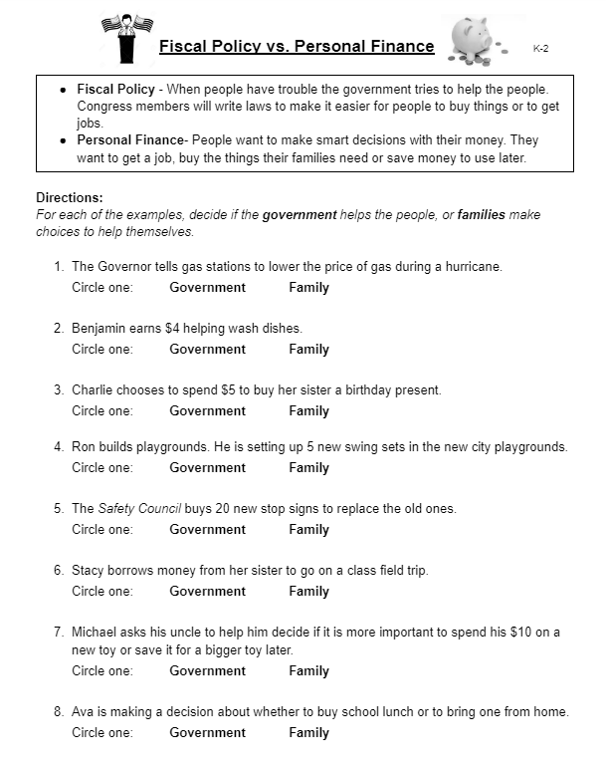
What is the difference between Fiscal Policy and Personal Finance?
K-2
The Governor tells gas stations to lower the price of gas during a hurricane.
Circle one: Government Family
Benjamin earns $4 helping wash dishes.
Circle one: Government Family
Charlie chooses to spend $5 to buy her sister a birthday present.
Circle one: Government Family
Ron builds playgrounds. He is setting up 5 new swing sets in the new city playgrounds.
Circle one: Government Family
https://docs.google.com/document/d/1Ox6CaSDmMfnY1iB0pvZwSkqaGhMUYwffItoNo9-6LS8/edit?usp=sharing

Slide 28
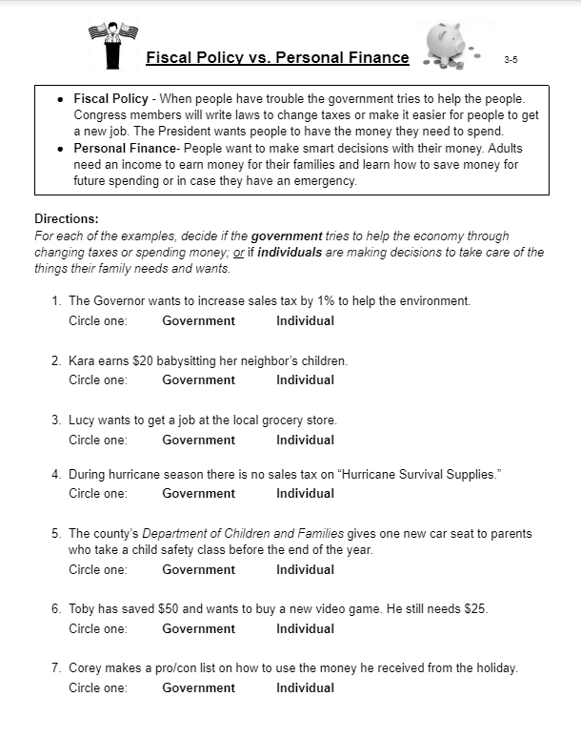
What is the difference between Fiscal Policy and Personal Finance?
3-5
The Governor wants to increase sales tax by 1% to help the environment.
Circle one: Government Individual
Kara earns $20 babysitting her neighbor’s children.
Circle one: Government Individual
Lucy wants to get a job at the local grocery store.
Circle one: Government Individual
During hurricane season there is no sales tax on “Hurricane Survival Supplies.”
Circle one: Government Individual
https://docs.google.com/document/d/1Ox6CaSDmMfnY1iB0pvZwSkqaGhMUYwffItoNo9-6LS8/edit?usp=sharing

Slide 29
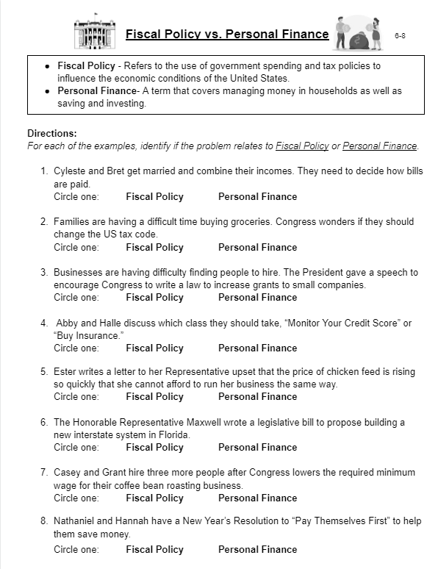
What is the difference between Fiscal Policy and Personal Finance?
6-8
Cyleste and Bret get married and combine their incomes. They need to decide how bills are paid.
Circle one: Fiscal Policy Personal Finance
Families are having a difficult time buying groceries. Congress wonders if they should change the US tax code.
Circle one: Fiscal Policy Personal Finance
Businesses are having difficulty finding people to hire. The President gave a speech to encourage Congress to write a law to increase grants to small companies.
Circle one: Fiscal Policy Personal Finance
Abby and Halle discuss which class they should take, “Monitor Your Credit Score” or “Buy Insurance.”
Circle one: Fiscal Policy Personal Finance
https://docs.google.com/document/d/1Ox6CaSDmMfnY1iB0pvZwSkqaGhMUYwffItoNo9-6LS8/edit?usp=sharing

Slide 30
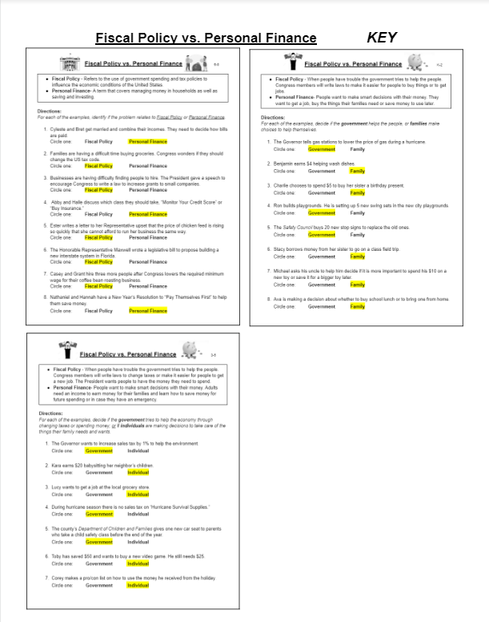
What is the difference between Fiscal Policy and Personal Finance?
K-2
3-5
6-8
Answer
Keys!!!!
https://docs.google.com/document/d/1Ox6CaSDmMfnY1iB0pvZwSkqaGhMUYwffItoNo9-6LS8/edit?usp=sharing

Slide 31
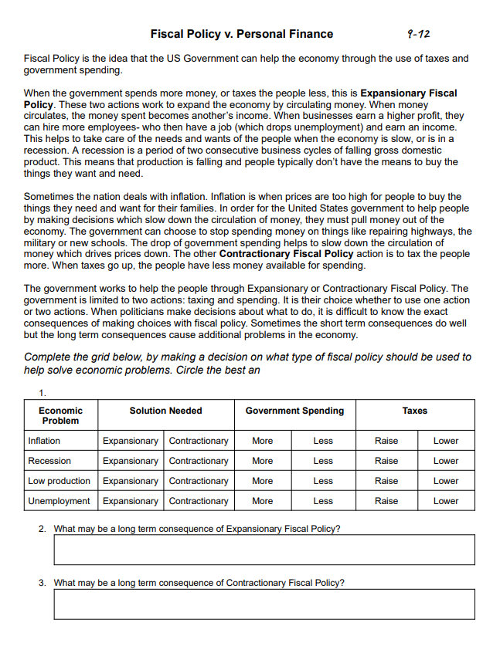
Fiscal Policy Student Practice:
9-12
What is Fiscal Policy?
Two Actions
Expansionary v. Contractionary
How should the Government act?
Anticipate the long term consequences.
Answer
Key!!!!
https://docs.google.com/document/d/199ZB9EVXwhgMWnvZrtu1vjLQenbkNEjqJ8FTGqUvoc8/edit?usp=sharing

Slide 32
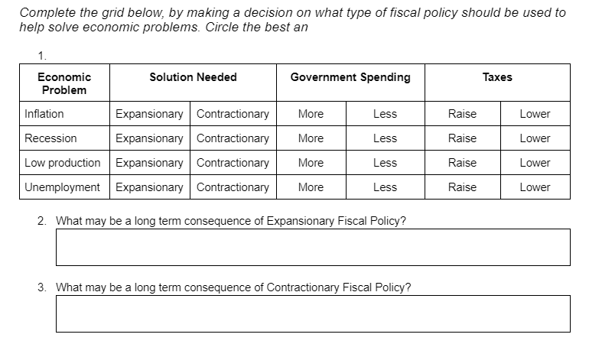
What is Fiscal Policy?
9-12
https://docs.google.com/document/d/199ZB9EVXwhgMWnvZrtu1vjLQenbkNEjqJ8FTGqUvoc8/edit?usp=sharing

Slide 33
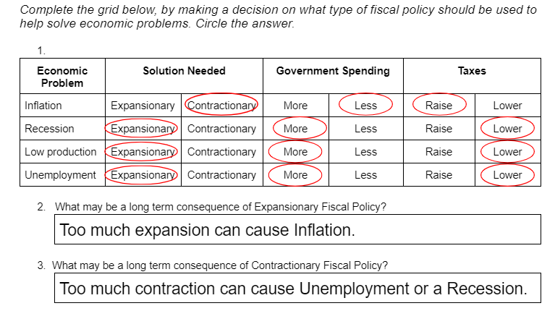
Answer
Key!!!!
https://docs.google.com/document/d/199ZB9EVXwhgMWnvZrtu1vjLQenbkNEjqJ8FTGqUvoc8/edit?usp=sharing

Slide 34
If we look back over history….
Over time, we are able to look back at history and see the turning points for some pretty amazing events. After time has gone by, we are able to see the benefits- economic and financial- from decisions made by the leaders of our country.
Let’s create an analogy and parallel “Fiscal Policy” and “Personal Finance.”
What if we imagine that the President (along with (his) Congress)- acting in the best interest of the nation… was parallel to the “Family Leader,” or the “Decision Maker” of a household.
Both the President and the “Household Decision Maker” make resolutions and commitments to benefit others in the future.
Using this assumption we will compare prior actions made by the US Presidents to possible choices one may make in a household to better the future of its lineage.

Slide 35
So…
The President is to the Nation.
AS
The “Household Decision Maker” is to the Family/Household.

Slide 36
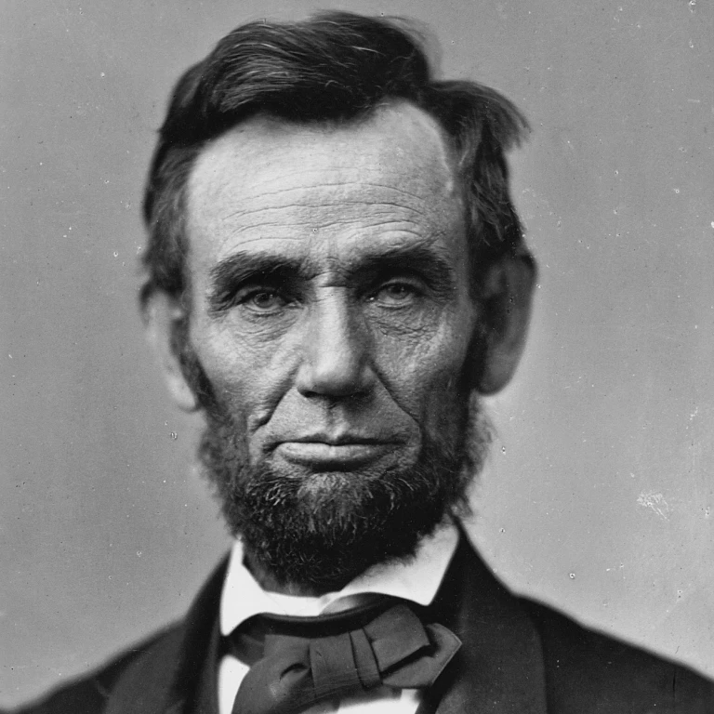
Abraham Lincoln
16th President of the White House
(1861-1865) Republican Party
Born 1809
American Prairie Lawyer
“Honest Abe” Nickname
16th President of the United States
VP: Hannibal Hamlin (1861-1865)
Commander in Chief during Civil War
Emancipation Proclamation
Reconstruction
VP: Andrew Johnson
Died 1865, 56 years

Slide 37
Abraham Lincoln
Fiscal Policy
The “Emancipation Proclamation” ignited a passion for Freedom among those fighting in the Civil War.
Ending Slavery Made Americans Richer
Ownership of labor and private property generates more wealth among Americans
Letters written: https://hudsonreview.com/2013/03/letters-from-america/#.Y7TrX3bMI2w
Personal Finance
Making Choices with Your Time
Finding a Job
Earning An Income

Slide 38
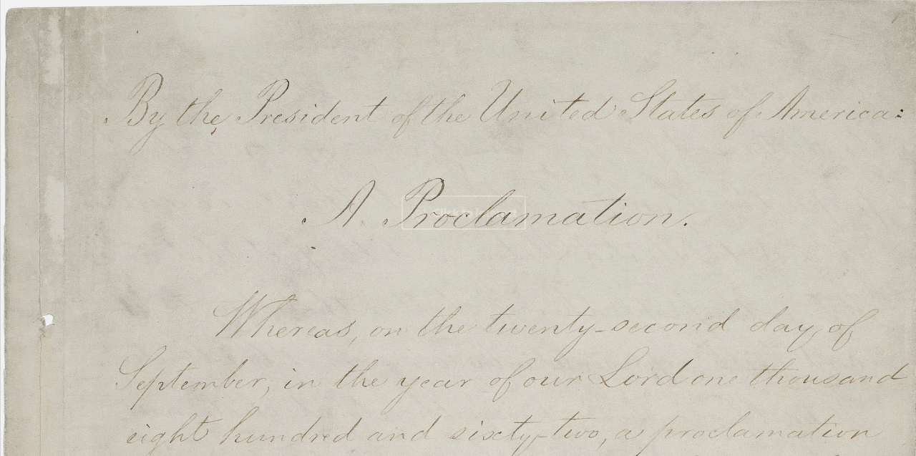
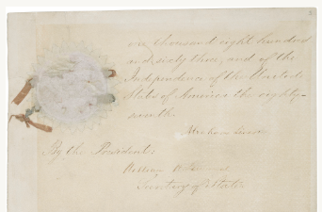
The Emancipation Proclamation, 1863
President Abraham Lincoln issued the Emancipation Proclamation on January 1, 1863, as the nation approached its third year of bloody civil war. The proclamation declared "that all persons held as slaves" within the rebellious states "are, and henceforward shall be free."
archives.gov
https://catalog.archives.gov/id/299998?objectPage=9
Although the Emancipation Proclamation did not immediately free a single slave, it captured the hearts and imagination of millions of African Americans, and fundamentally transformed the character of the war from a war for the Union into a war for freedom.

Slide 39
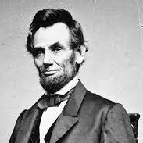
Transcription of the Proclamation
“Now, therefore I, Abraham Lincoln, President of the United States, by virtue of the power in me vested as Commander-in-Chief, of the Army and Navy of the United States in time of actual armed rebellion against the authority and government of the United States, and as a fit and necessary war measure for suppressing said rebellion, do, on this first day of January, in the year of our Lord one thousand eight hundred and sixty-three, and in accordance with my purpose so to do publicly proclaimed for the full period of one hundred days, from the day first above mentioned, order and designate as the States and parts of States wherein the people thereof respectively, are this day in rebellion against the United States, the following, to wit:
"That on the first day of January, in the year of our Lord one thousand eight hundred and sixty-three, all persons held as slaves within any State or designated part of a State, the people whereof shall then be in rebellion against the United States, shall be then, thenceforward, and forever free; and the Executive Government of the United States, including the military and naval authority thereof, will recognize and maintain the freedom of such persons, and will do no act or acts to repress such persons, or any of them, in any efforts they may make for their actual freedom.
https://www.archives.gov/exhibits/featured-documents/emancipation-proclamation/transcript.html <National Archives>
Google Docs Transcription of the Proclamation with live link to archives.gov
And by virtue of the power, and for the purpose aforesaid, I do order and declare that all persons held as slaves within said designated States, and parts of States, are, and henceforward shall be free; and that the Executive government of the United States, including the military and naval authorities thereof, will recognize and maintain the freedom of said persons.

Slide 40
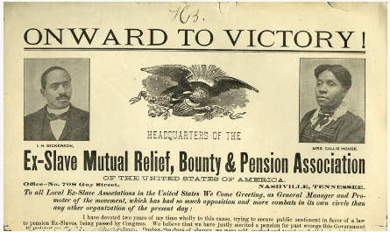
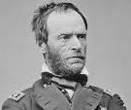
Union Victory!!!
The Union victory in the Civil War helped pave the way for the 13th amendment to formally abolish the practice of slavery in the United States. But following their emancipation, most former slaves had no financial resources, property, residence, or education—the keys to their economic independence.
In the late 19th century, the idea of pursuing pensions for ex-slaves—similar to pensions for Union veterans—took hold. If disabled elderly veterans were compensated for their years of service during the Civil War, why shouldn't former slaves who had served the country in the process of nation building be compensated for their years of forced, unpaid labor?
In the late stages of the Civil War and in its aftermath, the federal government (primarily Republicans) tried to relieve destitution among freedpeople and help them gain economic independence through attempts to allocate land. These efforts, both military and legislative, help explain why African Americans thought that compensation was attainable.
Special Field Orders No. 15, issued by Gen. William T. Sherman in January 1865, promised 40 acres of abandoned and confiscated land in South Carolina, Georgia, and northern Florida (largely the Sea Islands and coastal lands that had previously belonged to Confederates) to freedpeople. Sherman also decided to loan mules to former slaves who settled the land.
https://www.archives.gov/publications/prologue/2010/summer/slave-pension.html

Slide 41
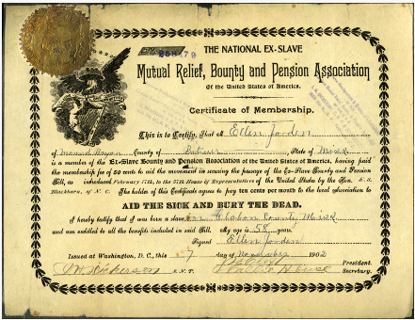
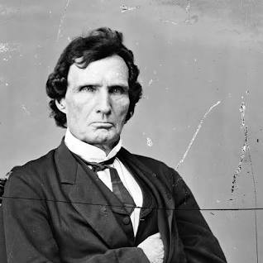
The Freedmen's Bureau Act had been established by Congress in March 1865 to help former slaves transition from slavery to freedom. Section four of the act authorized the bureau to rent no more than 40 acres of confiscated or abandoned land to freedpeople and loyal white refugees for a term of three years. At the end of the term, or at any point during the term, the male occupants renting the land had the option to purchase it and would then receive a title to the land.
In June 1866 the Southern Homestead Act was enacted. It was designed to exclusively give freedpeople and white southern loyalists first choice of the remaining public lands from five southern states until January 1, 1867.
Out of the lands thus seized and confiscated, the slaves who have been liberated by the operations of the war and the amendment of the Constitution or otherwise, who resided in said "confederate States" on the 4th day of March, A.D. 1861 or since, shall have distributed to them as follows namely: to each male person who is the head of a family, forty acres; to each adult male, whether the head of the family or not, forty acres; to each widow who is the head of a family, forty acres; to be held by them in fee simple, but to be inalienable for the next ten years after they become seized thereof. . . . At the end of ten years the absolute title to said homesteads shall be conveyed to said owners or to the heirs of such as are then dead.
Senator Thaddeus Stevens, a powerful Radical Republican leader, was a staunch advocate for emancipation and championed civil and equal rights for blacks.

Slide 42
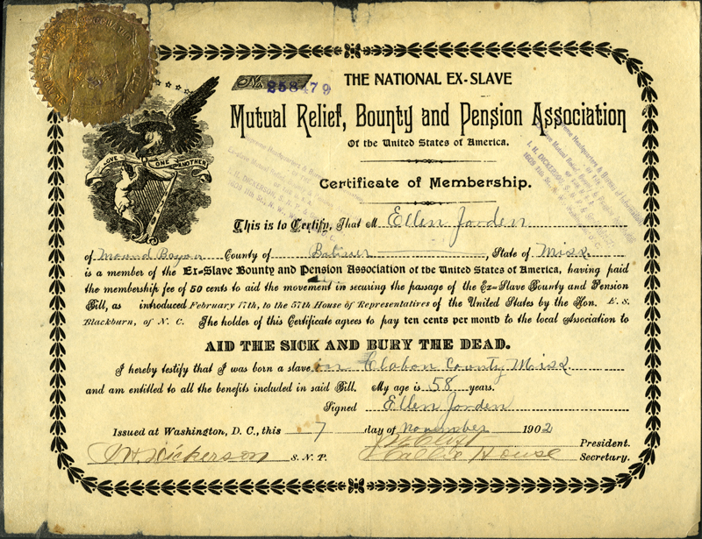
The National Ex-Slave
Mutual Relief, Bounty and Pension Association Of the United States of America
1
2
Certificate of Membership
This is to Certify, That M Ellen Jorden of Mound Bayou,County of Bolivar,State of Miss. is a member of the Ex-Slave Bounty and Pension Association of the United States of America, having paid the membership fee of 50 cents to aid the movement

Slide 43
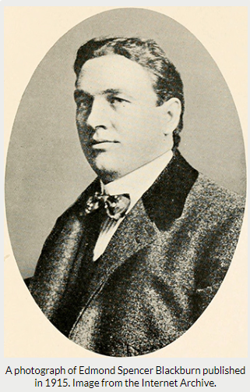
AID THE SICK AND BURY THE DEAD.
I hereby testify that I was born a slave in Claborn [sic] County Miss and am entitled to all the benefits included in said Bill, My
Age is 58 years.
Signed
Ellen Jorden Issued at Washington DC., this 7 day of November1902
3
having paid the membership fee of 50 cents to aid the movement in securing the passage of the Ex-Slave Bounty and Pension Bill as introduced February 17th, to the 57th House of Representatives of the United States by the Hon. E S Blackburn, of N.C. The holder of this certificate agrees to pay ten cents per month to the local Association to
4
Certificate of Membership

Slide 44
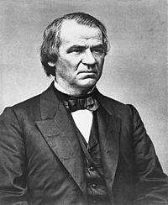
Civil Rights Act of 1866
The Civil Rights Act of 1866 declared all persons born in the United States to be citizens, "without distinction of race or color, or previous condition of slavery or involuntary servitude."
Although President Andrew Johnson vetoed the legislation, that veto was overturned by the 39th United States Congress and the bill became law. The Civil Rights Act of 1866 was the nation's first civil rights law.
First time Congress overrode a US Presidential veto.
President Andrew Johnson

Slide 45
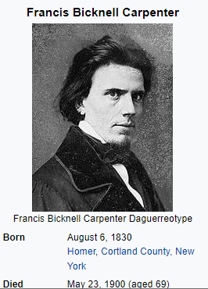
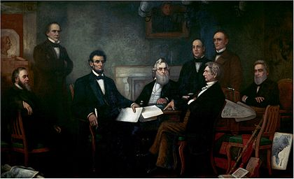
Emancipation Proclamation
Artist: Francis Bicknell Carpenter
Title: First Reading of the Emancipation Proclamation
by President Lincoln
Date: 1864
Depicted people
Shown from left to right are:
Edwin M. Stanton, secretary of war (seated);
Salmon P. Chase, secretary of the treasury (standing);
Abraham Lincoln;
Gideon Welles, secretary of the navy (seated);
Caleb Blood Smith, secretary of the interior (standing);
William H. Seward, secretary of state (seated);
Montgomery Blair, postmaster general (standing);
Edward Bates, attorney general (seated).
Also shown are:
Andrew Jackson, former president (painting centre);
Simon Cameron, former secretary of war (painting left).
What do you see?
What do you think?
What do you wonder?
Why did the artist use these colors?
5. What emotion might the artist be conveying?
6.

Slide 46
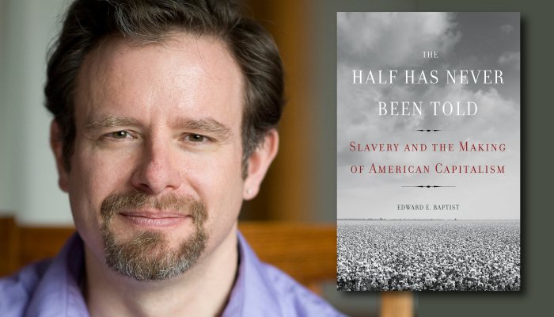
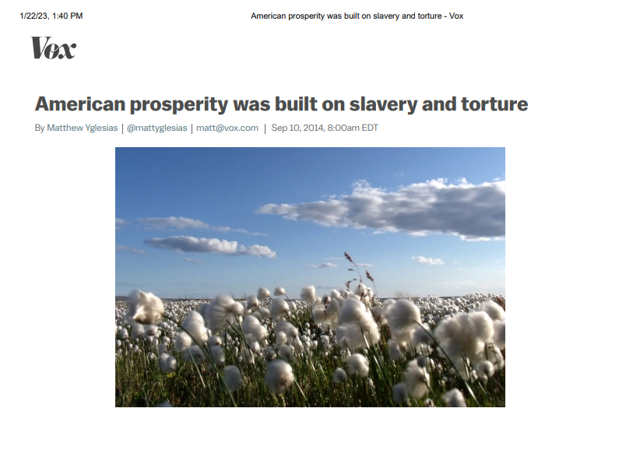
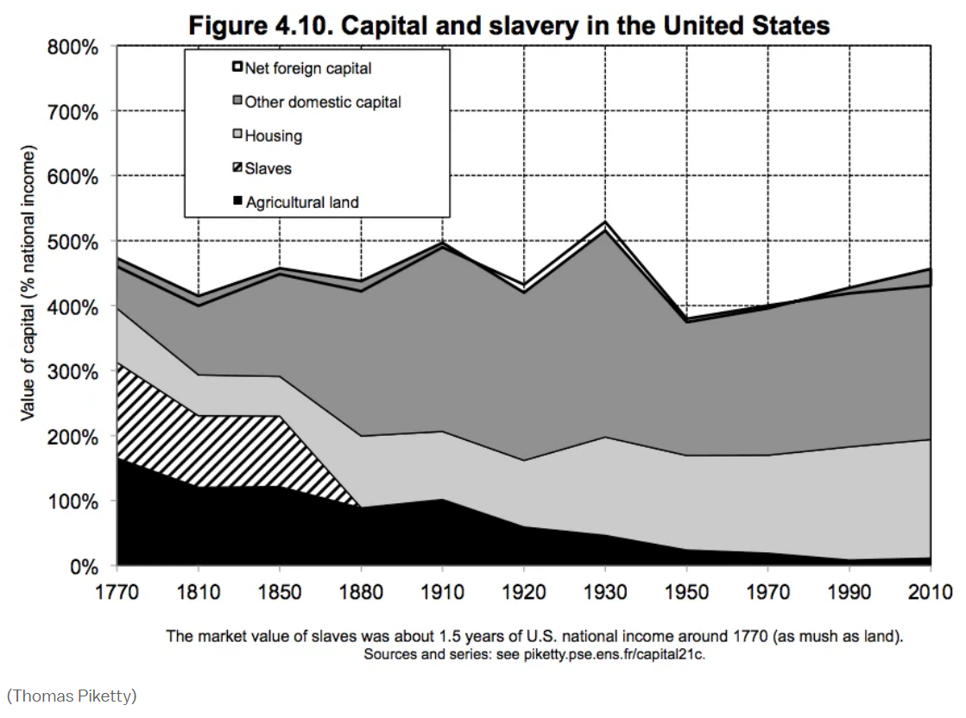
“American prosperity was built on slavery and torture”
Edward Baptist
Millions of people of African ancestry were held in bondage, making the idea of hard work as the ticket to success a joke. And possession of their labor was extremely valuable.
As this chart illustrates, slave wealth was slightly more valuable than all the agricultural land in the country put together. It was also more valuable than all the factories and railroads and canals combined.
In a world of relatively abundant land and high wages, owning black people was the key to wealth. And the process of emancipation was possibly the single greatest expropriation of wealth in human history.
4.10
Matt Yglesias
https://www.vox.com/2014/9/10/6109509/half-has-never-been-told-by-edward-baptist

Slide 47
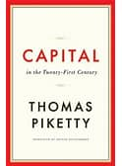
“Half Has Never Been Told”
“American prosperity was built on slavery and torture”
1
“Capital in the Twenty-First Century”
Thomas
Piketty- French
Economist
Edward Baptist- American Academic Writer
2
3
Matt Yglesias
“Ending Slavery Made America Richer”
Scott
Sumner-
American Economic
Professor
4

Slide 48
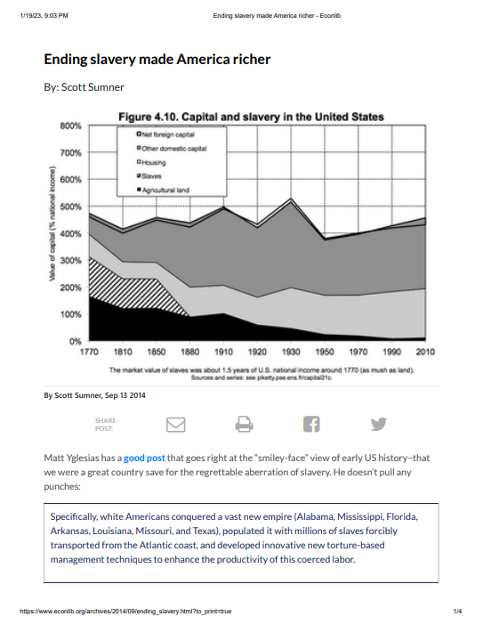
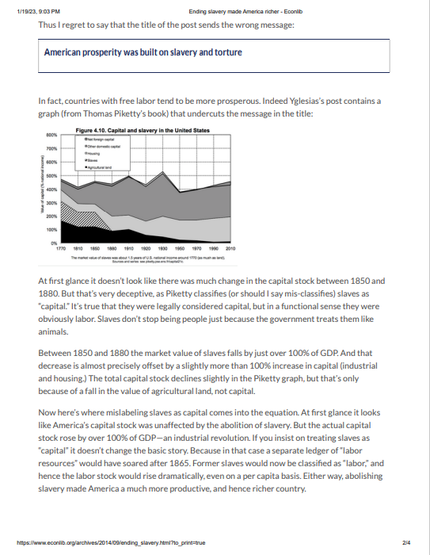
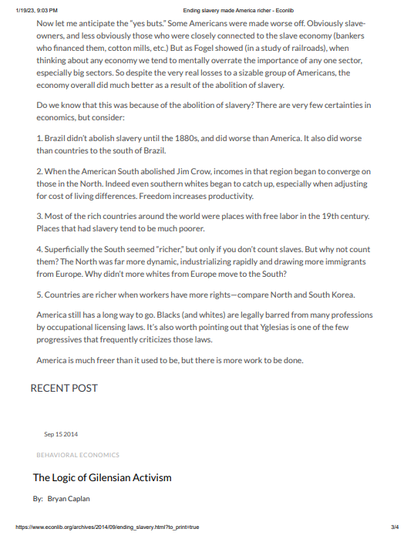
Ending Slavery Made Americans Richer
Article PDF link: https://drive.google.com/file/d/1CR_gKPFyV_GwES8UWZ3Ci3gkNAlRrewU/view?usp=sharing
Scott
Sumner-
American Economic
Professor

Slide 49
4.10
Piketty classifies (or should I say mis-classifies) slaves as “capital.” It’s true that they were legally considered capital, but in a functional sense they were obviously labor. Slaves don’t stop being people just because the government treats them like animals.
Scott Sumner

Slide 50
4.10
Between 1850 and 1880 the market value of slaves falls by just over 100% of GDP. And that decrease is almost precisely offset by a slightly more than 100% increase in capital (industrial and housing.) The total capital stock declines slightly in the Piketty graph, but that’s only because of a fall in the value of agricultural land, not capital.
Scott Sumner

Slide 51
In fact, countries with free labor tend to be more prosperous.
Critique: Yglesias post contains a graph (from Thomas Piketty’s book)
Now here’s where mislabeling slaves as capital comes into the equation. At first glance it looks like America’s capital stock was unaffected by the abolition of slavery. But the actual capital stock rose by over 100% of GDP—an industrial revolution.
If you insist on treating slaves as “capital” it doesn’t change the basic story.
Because in that case a separate ledger of “labor resources” would have soared after 1865.
Former slaves would now be classified as “labor,” and hence the labor stock would rise dramatically, even on a per capita basis.
Either way, abolishing slavery made America a much more productive, and hence richer country.
Scott Sumner
https://drive.google.com/file/d/1CR_gKPFyV_GwES8UWZ3Ci3gkNAlRrewU/view?usp=sharing

Slide 52
Now let me anticipate the “yes buts.”
Some Americans were made worse off.
Obviously slave-owners, and less obviously those who were closely connected to the slave economy (bankers who financed them, cotton mills, etc.)
Despite the very real losses to a sizable group of Americans, the economy overall did much better as a result of the abolition of slavery.
Scott Sumner
https://drive.google.com/file/d/1CR_gKPFyV_GwES8UWZ3Ci3gkNAlRrewU/view?usp=sharing

Slide 53
Do we know that this was because of the abolition of slavery?
There are very few certainties in economics, but consider:
1
1. Brazil didn’t abolish slavery until the 1880s, and did worse than America. It also did worse than countries to the south of Brazil.
2. When the American South abolished Jim Crow, incomes in that region began to converge on those in the North. Indeed even southern whites began to catch up, especially when adjusting for cost of living differences. Freedom increases productivity.
3. Most of the rich countries around the world were places with free labor in the 19th century. Places that had slavery tend to be much poorer.
Scott Sumner
https://drive.google.com/file/d/1CR_gKPFyV_GwES8UWZ3Ci3gkNAlRrewU/view?usp=sharing

Slide 54
Do we know that this was because of the abolition of slavery?
There are very few certainties in economics, but consider:
2
4. Superficially the South seemed “richer,” but only if you don’t count slaves. But why not count them? The North was far more dynamic, industrializing rapidly and drawing more immigrants from Europe. Why didn’t more whites from Europe move to the South?
5. Countries are richer when workers have more rights—compare North and South Korea.
Scott Sumner
America still has a long way to go. Blacks (and whites) are legally barred from many professions by occupational licensing laws. It’s also worth pointing out that Yglesias is one of the few progressives that frequently criticizes those laws.
America is much freer than it used to be, but there is more work to be done.
https://drive.google.com/file/d/1CR_gKPFyV_GwES8UWZ3Ci3gkNAlRrewU/view?usp=sharing

Slide 55
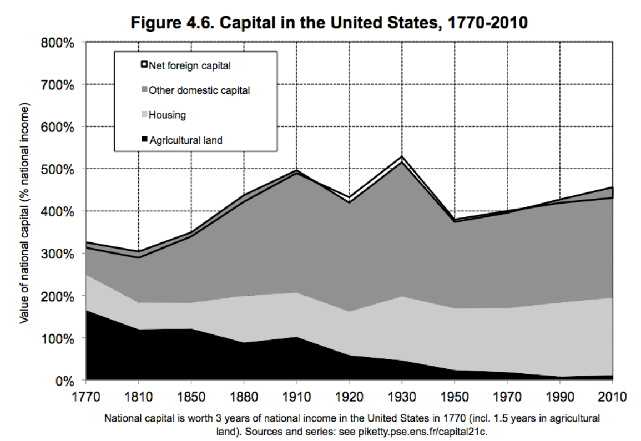
Thomas Piketty’s graphs:
Capital in the United States, 1770 - 2010 Capital and slavery in the United States
Figure 4.6 Figure 4.10

Slide 56
https://www.marxists.org/reference/archive/de-tocqueville/democracy-america/ch18.htm
Democracy In America Alexis de Tocqueville 1831
How can we visibly see that the lack of slavery was adding value to the people?
But this truth was most satisfactorily demonstrated when civilization reached the banks of the Ohio. The stream which the Indians had distinguished by the name of Ohio, or Beautiful River, waters one of the most magnificent valleys that has ever been made the abode of man. Undulating lands extend upon both shores of the Ohio, whose soil affords inexhaustible treasures to the laborer; on either bank the air is wholesome and the climate mild, and each of them forms the extreme frontier of a vast State: That which follows the numerous windings of the Ohio upon the left is called Kentucky, that upon the right bears the name of the river. These two States only differ in a single respect; Kentucky has admitted slavery, but the State of Ohio has prohibited the existence of slaves within its borders. ^{[21h]}

Slide 57
Alexis de Tocqueville 1831
Travels to study the American prison system were soon forgotten.
Travelled with Gustave de Beaumont
He wrote on his observations as he toured the United States.
He wrote letters home to family.
Podcast on some of his travels:
A steamboat docks along the Ohio River.
https://thumbwind.com/2020/03/02/fortnight-in-the-wilderness/

Slide 58
Letters from America
Alexis de Tocqueville
https://hudsonreview.com/2013/03/letters-from-america/#.Y83a-nbMI2x
To his father Memphis, December 20, 1831
PDF:
https://drive.google.com/file/d/18-3IOAKjF28WWBGxt-Lmm8wCW1EVdhn5/view?usp=sharing
Google Doc: https://docs.google.com/document/d/1bcV299aQ00x1HaubOEyUhCwjnzqUzyzPf4LluDB8OIw/edit?usp=sharing

Slide 59
The Ohio River Valley

Slide 60
Thus the traveller who floats down the current of the Ohio to the spot where that river falls into the Mississippi, may be said to sail between liberty and servitude; and a transient inspection of the surrounding objects will convince him as to which of the two is most favorable to mankind.
Kentucky Ohio
Upon the left bank of the stream the population is rare; from time to time one descries a troop of slaves loitering in the half-desert fields; the primaeval forest recurs at every turn; society seems to be asleep, man to be idle, and nature alone offers a scene of activity and of life.
From the right bank, on the contrary, a confused hum is heard which proclaims the presence of industry; the fields are covered with abundant harvests, the elegance of the dwellings announces the taste and activity of the laborer, and man appears to be in the enjoyment of that wealth and contentment which is the reward of labor. ^{[21i]}

Slide 61
https://www.tota.world/article/1860/
What do you see?
Which side of the Ohio River do you think the artist has drawn?
Why?

Slide 62
https://www.tota.world/article/1860/
What do you see?
Which side of the Ohio River do you think the artist has drawn?
Why?

Slide 63
https://docs.google.com/document/d/1n4-g0-2JOSLbVlb2UVnrADBoZvPEuoPOFqfO2CS9uhw/edit?usp=sharing
Draw a picture inside each state to represent what Alexis may have seen as his steamboat traveled down the Ohio River.
3-5

Slide 64
Kentucky Ohio
Ohio
Kentucky
The State of Kentucky was founded in 1775, the State of Ohio only twelve years later; but twelve years are more in America than half a century in Europe, and, at the present day, the population of Ohio exceeds that of Kentucky by two hundred and fifty thousand souls. ^{[21j]} These opposite consequences of slavery and freedom may readily be understood, and they suffice to explain many of the differences which we remark between the civilization of antiquity and that of our own time.

Slide 65
6-8
Ohio
Kentucky Ohio
Kentucky
During this time, Kentucky was a slave state, and Ohio a free state. What kinds of differences may Alexis de Tocqueville have seen as he traveled along the Ohio River?
Draw the things that Alexis may have seen along the river, looking at the land on either side of the river.

Slide 66
If Kentucky was a slave state, and Ohio a free state, what kinds of differences may Alexis de Tocqueville have seen as he traveled along the Ohio River?
6-8
Imagine you are writing a letter to a friend about what they missed learning about in class today. Write about the differences that Alexis would have seen along the Northern and Southern shores of the Ohio River.
Ohio
Kentucky Ohio
Kentucky

Slide 67
Read the following excerpt from Alexis de Tocqueville’s book. Take notes on the differences between Ohio and Kentucky.
Write a paragraph about what you can deduce about the value of freedom of labor by comparing Ohio and Kentucky.
9-12
Left and Right Banks of the Ohio: TOTA Article (w/ art) https://docs.google.com/document/d/1bcV299aQ00x1HaubOEyUhCwjnzqUzyzPf4LluDB8OIw/edit?usp=sharing
Excerpt from Tocqueville: Democracy in America (from reference archive) https://docs.google.com/document/d/1oy43ih-ThOEzxHw0XtQXWdVEUE_YitjLUJX9YFP1kaI/edit?usp=sharing

Slide 68
Personal Finance
Abraham Lincoln
Income and Career
Owning your labor is essential to capitalism.
Having the right to your own career allows you to earn money for your household.
What are the benefits to having a job?
LESSONS:
Navigate: Exploring College and Careers
Could You Earn a Million Dollars?
Is Your Next Job a Text or Tweet Away?
Can You Afford To Move Out?
Do You Want to Work for Someone Else or for Yourself?
If We Have Economic Growth Why Are Some Families Struggling?

Slide 69
Teddy Roosevelt
26th President of the White House
(1901-1909) Republican Party
Born 1858
Author, Historian
Conservationist, Naturalist, Explorer, Sportsman
VP to President William McKinley
26th President of the United States
The “Conservationist President”
Established National Park System
Nobel Peace Prize Winner 1906
Panama Canal
VP: none (1901-1905) Charles Fairbanks (1905-1909)
Died 1919

Slide 70
President Theodore Roosevelt: National Parks
Fiscal Policy
Teddy Roosevelt spent national money on expanding the Federal Park System.
These parks gave jobs to individuals.
Spending money on leisure time.
Spending your down time (not earning money) has benefits.
Personal Finance
Job Creation
Leisure time- how do you spend your down time?
How can it benefit you?

Slide 71
Economic Impact of National Parks
Can filter this website by park!

Slide 72
How did Americans have fun in the 1900s?
How did Americans have fun in the late 1800s and early 1900s?
How do Americans have fun today?
How do you have fun?

Slide 73
The Cost of National Parks
English General Paper (EGP)
Vocabulary
Summarize
Paraphrase
Using Data

Slide 74
The Cost of National Parks
https://www.nps.gov/orgs/1207/vse2020.htm

Slide 75
National Park Ranger Application Activity

Slide 76
Road Trippin’ through the National Park System

Slide 77
National Park Service Educator Resources
Theme, Time Period, State

Slide 78
Personal Finance
Teddy Roosevelt
Leisure Time & Getting a Job
The National Park System has been instrumental in playing a part in our citizen’s down time.
Rest and relaxation as well as exploration are important.
How do you use your time?
These parks have employed thousands of people over time. Decreasing unemployment is healthy for our economy. Households need a steady income to be successful.
LESSONS:
Are You A Screen Teen?
How Do Gas Prices Impact Decisions?
How Do I Plan for a Job or Career?
Leisure Time and Sleep: Early to Bed....

Slide 79
Franklin Delano Roosevelt
32nd President of the White House
(1933- 1945) Democrat Party: 4 terms !!!
Born 1882
32nd President of the United States
VP: John Nance Garner (1933-1941); Henry A. Wallace (1941-1945); Harry S. Truman (Jan- April 1945)
New Deal
Glass-Steagall Act
WPA
Social Security
SEC
Fireside Chats
Died 1945, 63 years
Supreme Court Packing
National Recovery Act
World War II
Japanese Internment
Tehran Conference
United Nations
D-Day
Bill of Economic Rights
GI Bill
Yalta Conference

Slide 80
Economic Consequences of the New Deal
Fiscal Policy Personal Finance
The New Deal of the 1930’s helped revitalize the US economy after the Great Depression.
Many believe that the length and depth of the Great Depression, and was cut short.
The New Deal was a federally-funded set of improvements across America.
Consequently, many jobs were created for workers as well as profits for businesses.
Social Security remains one of the most popular programs that are still present today.
Income rose
Unemployment fell
Businesses were more productive and industries flourished.
New Deal Economic Effects

Slide 81
https://www.usgovernmentspending.com/
The Big Shove of Government Spending!
So many ways to look up info!
usGovernmentspending.com

Slide 82
Money, Money, Money!
Compare itemized spending to spending as a whole.
Percents
Pie Charts!
Analyze
What does this mean?
What do you think?
Why do you believe it was ________?

Slide 83
Federal Debt!
Compare
Find the Difference Between
Find Percent Change
What do you think caused the change?
Find the Fiscal Policy solution to solve the problem.

Slide 84
Entitlement Spending!
Compare entitlement spending past and present.
Compare part to the whole.
Percentages
Pie Charts

Slide 86
Personal Finance
Franklin D. Roosevelt
Saving, Investing, Retirement
The New Deal brought an abundance of spending in an attempt to decrease the effects of the recession. How do families better the conditions of their household?
Government spending adds to the production of the United States providing many new jobs, particularly through the WPA: Works Progress Administration. Getting a job is important to help provide for your family.
3. Having a steady income allows you to save and invest for retirement. Many people use the
Social Security programs to help meet their goals for retirement today.
LESSONS:
How Do I Save Money?
How Do People Save For the Future?
What Is Compound Interest and How Does It Matter?
Living Paycheck to Paycheck
Which Stock Would You Choose?
How Do You Safeguard Your Investments?
Bull and Bear Market
Which Stock Would You Choose?
Making Personal Finance Decisions

Slide 87
Dwight Eisenhower
34th President of the White House
(1953-1961) Republican Party
Born 1890
34th President of the United States
Interstate Highway System
Space Race
Korean War
Eisenhower Doctrine
1960 U-2 incident
Civil Rights Act
Desegregating Armed Forces
Alaska and Hawaii admitted into the union
22nd Amendment: 2 term Presidential limit
VP: Richard Nixon
Died 1969x, 78 years

Slide 88
Dwight Eisenhower
Fiscal Policy
Interstate Highway
Economic Efficiency
Economic Productivity
Civil Rights Act
Equal and better opportunities
Personal Finance
Buying or Leasing a car
Taking the bus
How to get to work
Value of transportation:
Get to a doctor
Take a vacation
Get to work
Visit family

Slide 89
The Interstate Highway System
The interstate highway system has had a profound effect upon the American economy and contributed significantly to improved economic efficiency and productivity.
By increasing speed and expanding access, freight costs have been reduced substantially. Tractor-trailer operating costs have been estimated at 17 percent lower on interstate highways than other highways.
Each dollar of investment in highways produces an annual reduction in product costs of 23.4 cents, with larger cost reductions in the early years and smaller reductions in more recent years. (1996)
After Dwight D. Eisenhower became president in 1953, his administration developed a proposal for an interstate highway system, eventually resulting in the passage of the Federal Aid Highway Act of 1956.
Unlike the earlier U.S. Highway System, the Interstates were designed to be an all-freeway system, with nationally unified standards for construction and signage.
FDR’s hand drawn map.
http://www.publicpurpose.com/freeway1.htm#:~:text=The%20interstate%20highway%20system%20has%20had%20a%20profound%20effect%20upon,costs%20have%20been%20reduced%20substantially

Slide 90
The Interstate Highway System
The Interstate Highway System gained a champion in President Dwight D. Eisenhower, who was influenced by his experiences as a young Army officer crossing the country in the 1919 Motor Transport Corps convoy that drove in part on the Lincoln Highway, the first road across America. He recalled that, "The old convoy had started me thinking about good two-lane highways... the wisdom of broader ribbons across our land." Eisenhower also gained an appreciation of the Reichsautobahn system, the first "national" implementation of modern Germany's Autobahn network, as a necessary component of a national defense system while he was serving as Supreme Commander of Allied Forces in Europe during World War II. In 1954, Eisenhower appointed General Lucius D. Clay to head a committee charged with proposing an interstate highway system plan.
It was evident we needed better highways. We needed them for safety, to accommodate more automobiles. We needed them for defense purposes, if that should ever be necessary. And we needed them for the economy. Not just as a public works measure, but for future growth.

Slide 91
Alexis de Tocqueville on Transportation in America
https://www.fhwa.dot.gov/infrastructure/alexis.cfm

Slide 92
Personal Finance
Dwight Eisenhower
Income and Career
Spending money on the road system helped to better citizen’s future in America.
What should you invest in to help you make better decisions for the future?
LESSONS:
Five Things Not To Say When Buying A Car
Would You Buy A Self Driving Car?
Do You Love That Car?
Are You Prepared for College or a Career?
Would You Invest in Uber?
To College Loan or Not
College Prep for Babies... Financial Babies
Is Debt Scaring You Away from College?

Slide 93
Lyndon B. Johnson
36th President of the White House
(1963-1969) Democrat Party
Born August 27, 1908
36th President of the United States
Signs the Civil Rights Act of 1964
Gulf of Tonkin Resolution
Economic Opportunity Act
Elementary and Secondary Act
Medicare, Medicaid created
Voting Rights Act became a law
Miranda v. Arizona
Thurgood Marshall Supreme Court Justice
Died January 22, 1973, 64 years old

Slide 94
Who was LBJ? Virtual Tour of LBJ’s Texas White House
Lyndon B. Johnson National Historical Park will receive approximately $7.8 million to rehabilitate the historic Texas White House, nearby communications buildings, and the surrounding site.

Slide 95
The Approach to the New Fiscal Year
Who is the ‘he’ that Johnson is referring to in this clip? How do you know?
What are items that LBJ believes are important to have in the Federal Budget?
What is considered “throwing money away” and “being wasteful” to Johnson?
Who does LBJ consider a hero? Why?

Slide 96
LBJ’s Economic Report of the President

Slide 97
LBJ’s Budget Increase
Discussion:
How important is a budget?
How did LBJ’s budgetary increase affect taxes?
How would a budgetary increase affect Americans?
What makes LBJ’s spending different from other presidents?
“Under my 1965 budget proposals the Federal Government will spend an estimated $19 billion from budget and trust funds for benefits and services for older persons.”
Statement by the President Upon Making Public the Report of the President's Council on Aging--February 9, 1964
The annual earnings subject to Social Security taxes should be increased from $4,800 to $5,200.
Special Message to the Congress on the Nation's Health--February 10, 1964
“I recommend that the separate grant programs for chronic disease hospitals and nursing homes be combined into a single category of long-term care facilities. The annual appropriation for the combined categories should be increased from $40 million to $70 million.”
Special Message to the Congress on the Nation's Health--February 10, 1964
“My 1965 budget includes a total of $467 million for the National Institute of Mental Health and for mental retardation activities.”
Special Message to the Congress on the Nation's Health--February 10, 1964

Slide 98
Lyndon B. Johnson and Ronald Reagan and Federal Power
What were the goals of the “Great Society”?
What types of measures did Johnson recommend to Congress?
What was the key message of Reagan’s First Inaugural Address?
What actions did Reagan take to bring about his goal of decreasing the size of the federal government?
How would you assess the constitutionality of each President’s actions?

Slide 99
LBJ Economic Policies
What was the increase in the budget when LBJ was in office?
What laws did he pass during his War on Poverty?
How can these laws affect the Federal Budget?
Why did LBJ believe in the Great Society?
What were the budgetary results of the Great Society?
How did President Johnson help the National Park Service?

Slide 100
Personal Finance
Lyndon B. Johnson
Budget & Spending Wisely
Understanding the importance of a budget can go a long way.
Budgeting is not just for right now, but important for future accomplishments.
How do you spend and save money?
LESSONS:
If We Have Economic Growth, Why are Some Families Struggling?
What’s A Budget?
How Many People Live Paycheck-to-Paycheck?
Why Do People Save for the Future?

Slide 101
George W. Bush
43rd President of the White House
(2001-2009) Republican Party
Born 1946
43rd President
Entered office during dot-com bubble
September 11, 2001
No Child Left Behind Act
War on Terror (Afghanistan invasion)
Patriot Act
Iraq invasion: Iraq War
North Korea condemnation
Hurricane Katrina
2008 economic crisis: The Great Recession
VP: Dick Cheney

Slide 102
Barack Obama
44th President of the White House
(2009-2017) Democrat Party
Born 1961
44th President of the United States
Russia Nuclear Treaty
Affordable Care Act
Dodd-Frank Wall Street Reform and Consumer Protection Act
Iraq & Afghanistan withdrawal
Killing of Osama bin Laden
Libya Intervention
Afghanistan withdrawal
Iran Nuclear Deal
Cuban Thaw
VP: Joe Biden
Sanctions against
Russia
Obergefell v. Hodges
Paris Agreement

Slide 103
President George W. Bush & Barack President Obama
Fiscal Policy
George Bush and Barack Obama highlighted the importance of personal finance education.
Education is essential for progress, particularly financial progress.
Spending part of your budget on the education of your future is important!
Personal Finance
Education!
Better/ more education OFTEN leads to more wealth.
Budget!
College
Career/ Continued education.

Slide 104
George W. Bush:
George W. Bush authorized a President’s Advisory Council on Financial Literacy in 2008.
Bush’s famous vision was of an ownership society. “We want people to own assets,” he said in authorizing the first council. “We want people to be able to manage their assets.”
Google Doc: https://time.com/16425/the-presidents-new-mission-teach-the-children-about-money/

Slide 105
Timeline:
2003- (Bush) Financial Literacy and Education Commission
2008- (Bush) President’s Advisory Council on Financial Literacy
2013- (Obama) President's Advisory Council on Financial . Capability for Young Americans

Slide 106
George W. Bush:
2003:
The Financial Literacy and Education Commission was established under the Fair and Accurate Credit Transactions Act of 2003. The Commission was tasked to develop a national financial education website (MyMoney.gov) and a national strategy on financial education. It is chaired by the Secretary of the Treasury and the vice chair is the Director of the Bureau of Consumer Financial Protection. The Commission is coordinated by the Department of the Treasury's Office of Consumer Policy.
https://www.loc.gov/item/lcwaN0016852/

Slide 107
About MyMoney.gov
This website is a product of the Congressionally chartered Federal Financial Literacy and Education Commission (FLEC), which is made up of more than 20 Federal entities that are coordinating and collaborating to strengthen financial capability and increase access to financial services for all Americans. The Commission was established by the Financial Literacy and Education Improvement Act, Title V of the Fair and Accurate Credit Transactions Act of 2003 (P.L. 108-159).
The Secretary of the Treasury chairs the Commission, and the Director of the Consumer Financial Protection Bureau is the vice-chair.

Slide 108
MyMoney.Gov:

Slide 109
MyMoney.Gov:

Slide 110
https://www.mymoney.gov/for-teachers

Slide 111
https://www.mymoney.gov/mymoneyfive

Slide 112
Barack Obama 2013
On June 25, 2013, President Obama signed Executive Order 13646 creating a new President's Advisory Council on Financial Capability for Young Americans. The Council will advise the President and the Secretary of the Treasury on how to promote financial capability among young Americans and encourage building the financial capability of young people at an early stage in schools, families, communities, and the workplace and through use of technology. These recommendations will contribute to the nation's future financial stability and increase upward economic mobility. Strengthening the financial capability of our young people is an investment in our nation's economic prosperity.
The mission took on a new look under President Obama, who in his first term reconstituted the board under the new name: President’s Advisory Council on Financial Capability, swapping “Literacy” for “Capability.”
New Look!

Slide 113
Personal Finance
George W. Bush
& Barack Obama
Education, Budgeting,
Personal Finance Education
Receiving an education in personal finance is crucial.
Families that spend time learning how to make a budget, spend wisely, save for emergencies and invest well are better off than those who do not.
LESSONS:
How Many People Live Paycheck-to-Paycheck?
College Prep for Babies... Financial Babies
Is Debt Scaring You Away from College?
What is A Budget?
Should I rent or Buy?

Slide 114
Personal Finance: Debt
https://www.personalfinanceclub.com/how-did-the-us-budget-deficit-perform-based-on-the-president/

Slide 115
Choose a President that you heard about today….
In your group create a Personal Finance meme using this president.
*All of these images are the result of internet searches… the are not USF’s.
Abraham Lincoln
George W. Bush
Lyndon B Johnson
John Adams
Teddy Roosevelt
George Washington
Franklin D Roosevelt
Dwight Eisenhower
James Madison
Woodrow Wilson
Barack Obama

Slide 118
Teacher Pedagogy Resources:
Just for Teachers
Benefits of the American Revolution: An Exploration of Positive Externalities https://www.econlib.org/library/Columns/y2018/HummelAmericanrevolution.html
The Economic Effects of American Slavery https://egc.yale.edu/sites/default/files/Economic%20History%20Conferences/2021-09/Border%20paper%20draft%20v15.pdf
ABRAHAM LINCOLN: IMPACT AND LEGACY https://millercenter.org/president/lincoln/impact-and-legacy
Fiscal Policy: Economic Effects https://sgp.fas.org/crs/misc/R45723.pdf
Alexis de Tocqueville Democracy in America https://www.marxists.org/reference/archive/de-tocqueville/democracy-america/ch18.htm
US Flags Over Time: https://www.usflagdepot.com/store/page8.html
Teddy Roosevelt: The Man, the Myth, and the Economic Promise https://www.slideshare.net/Yumonomics/teddy-roosevelt-presentation-66520035

Slide 119
Labor Force https://www2.census.gov/library/publications/1975/compendia/hist_stats_colonial-1970/hist_stats_colonial-1970p1-chD.pdf
https://www.usgovernmentspending.com/past_spending
https://due.com/blog/richest-presidents-in-us-history/
https://www.theodorerooseveltcenter.org/About-Us/News/Item/Digitization%20Update%20November%202022
https://www.loc.gov/collections/america-at-work-and-leisure-1894-to-1915/articles-and-essays/america-at-leisure/

Slide 120
https://www.whitehouse.gov/omb/budget/historical-tables/
https://fiscaldata.treasury.gov/americas-finance-guide/federal-spending/#spending-trends-over-time-and-the-us-economy
https://historyinpieces.com/research/us-unemployment-rates-president

Slide 121
Standards:
Personal Financial Literacy Standards

Slide 122
Financial Literacy Standards Covered
SS.912.FL.1.5:Discuss reasons why changes in economic conditions or the labor market can cause changes in a worker’s income or may cause unemployment.
SS.912.FL.2.1:Compare consumer decisions as they are influenced by the price of a good or service, the price of alternatives, and the consumer’s income as well as his or her preferences.
SS.912.FL.2.2:Analyze situations in which when people consume goods and services, their consumption can have positive and negative effects on others.
SS.912.FL.3.1:Discuss the reasons why some people have a tendency to be impatient and choose immediate spending over saving for the future.
SS.912.FL.4.8:Examine the fact that failure to repay a loan has significant consequences for borrowers such as negative entries on their credit report, repossession of property (collateral), garnishment of wages, and the inability to obtain loans in the future.
SS.912.FL.4.11:Explain that people often apply for a mortgage to purchase a home and identify a mortgage is a type of loan that is secured by real estate property as collateral.
SS.912.FL.5.10:Explain that people vary in their willingness to take risks because the willingness to take risks depends on factors such as personality, income, and family situation.

Slide 123
Financial Literacy Standards Covered
SS.912.FL.2.3: Discuss that when buying a good, consumers may consider various aspects of the product including the product’s features. Explain why for goods that last for a longer period of time, the consumer should consider the product’s durability and maintenance costs.
SS.8.FL.2.1 Explain why when deciding what to buy, consumers may choose to gather information from a variety of sources. Describe how the quality and usefulness of information provided by sources can vary greatly from source to source. Explain that, while many sources provide valuable information, other sources provide information that is deliberately misleading.
SS.912.FL.2.5 Discuss ways people incur costs and realize benefits when searching for information related to their purchases of goods and services and describe how the amount of information people should gather depends on the benefits and costs of the information.
SS.4.FL.2.6 Predict how people's spending choices are influenced by prices as well as many other factors, including advertising, the spending choices of others, and peer pressure.
SS.8.FL.2.1 Explain why when deciding what to buy, consumers may choose to gather information from a variety of sources. Describe how the quality and usefulness of information provided by sources can vary greatly from source to source. Explain that, while many sources provide valuable information, other sources provide information that is deliberately misleading. your buying decisions?
SS.912.FL.2.3 Discuss that when buying a good, consumers may consider various aspects of the product including the products features. Explain why for goods that last for a longer period of time, the consumer should consider the products durability and maintenance costs.
SS.912.FL.2.6 Explain that people may choose to donate money to charitable organizations and other not-for-profits because they gain satisfaction from donating.
SS.912.FL.2.1: Compare consumer decisions as they are influenced by the price of a good or service, the price of alternatives, and the consumer’s income as well as his or her preferences.
SS.912.FL.2.2: Analyze situations in which when people consume goods and services, their consumption can have positive and negative effects on others.
SS.912.FL.2.3: Discuss that when buying a good, consumers may consider various aspects of the product including the product’s features. Explain why for goods that last for a longer period of time, the consumer should consider the product’s durability and maintenance costs.
SS.912.FL.5.2: Explain how the expenses of buying, selling, and holding financial assets decrease the rate of return from an investment.
SS.912.FL.6.4 Explain that people may be required by governments or by certain types of contracts (e.g., home mortgages) to purchase some types of insurance.
SS.912.FL.1.7 Discuss how peoples sources of income, amount of income, as well as the amount and type of spending affect the types and amounts of taxes paid.

Slide 124
Find Out More!

Slide 125
Stay Up To Date!

Slide 126
Scroll Down to Register:

Slide 127
Want MORE???
Stavros Center Resources

Slide 128
Peter Trakas, Director for the USF Stavros Center.
Dick Piglisi, Director for the Stavros Center accepts State Farm’s grant for continued Personal Finance Education.

