Slide 1
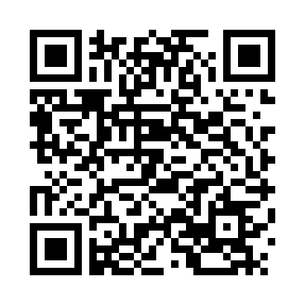


RISKY
BUSINESS
CYBER
RISKS
http://tinyurl.com/USFStavrosRiskyBusiness
Deborah Kozdras, Ph.D.
dkozdras@usf.edu

Slide 2
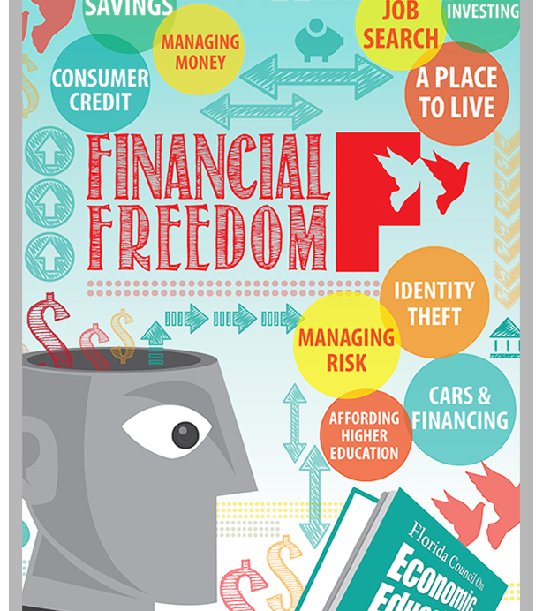
Identity Theft
All an identity thief requires is your:
1) name,
2) date of birth
3) social security number.

Slide 3
Avoid Identity Theft
First Defense: Safe Passwords
Superman – 26 Seconds
SupermanFlies – 300 Years
SupermanFlies! 6,000 years
Superman5Flies! – Over a Million Years
Using these criteria, create a password for your favorite star (sports, music, or movie).

Slide 4
Mnemonic Passwords
Mnemonic Passwords: Another way of making a password is to create a mnemonic password. Select the first letter of each word of a secret sentence. For example My Friend Jane Eats 2 Apples Every Day to Stay Very Healthy would become MFJE2AEDTSVH.
Create your own mnemonic password: ____________________________________________________________________________________________________

Slide 5
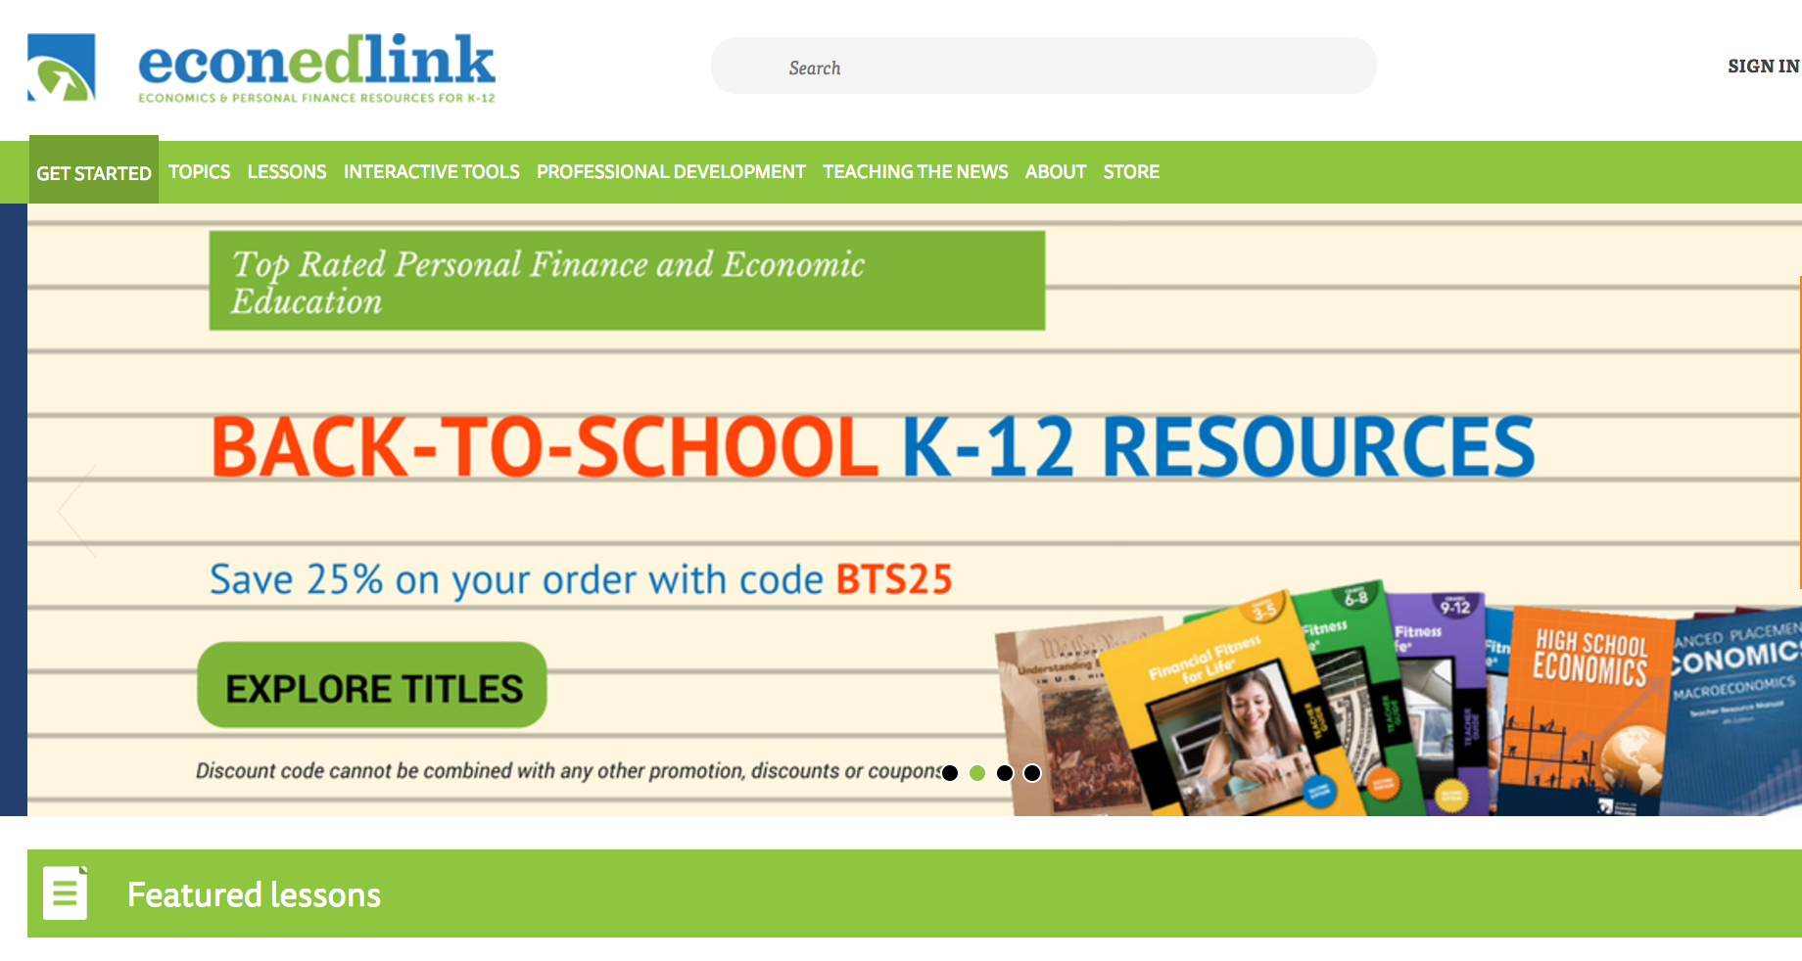
Cybersecurity Lessons
I am a ten-year old boy. I play soccer and tennis. I like to meet people online and play games. My favorite food is bacon.
How would these people look, based on their profiles?
Cybersecurity, Economics, and Personal Finance
www.EconEdLink.org

Slide 6
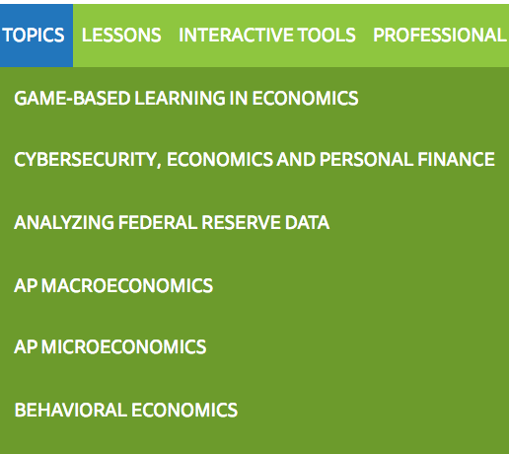
Cybersecurity Lessons

Slide 7
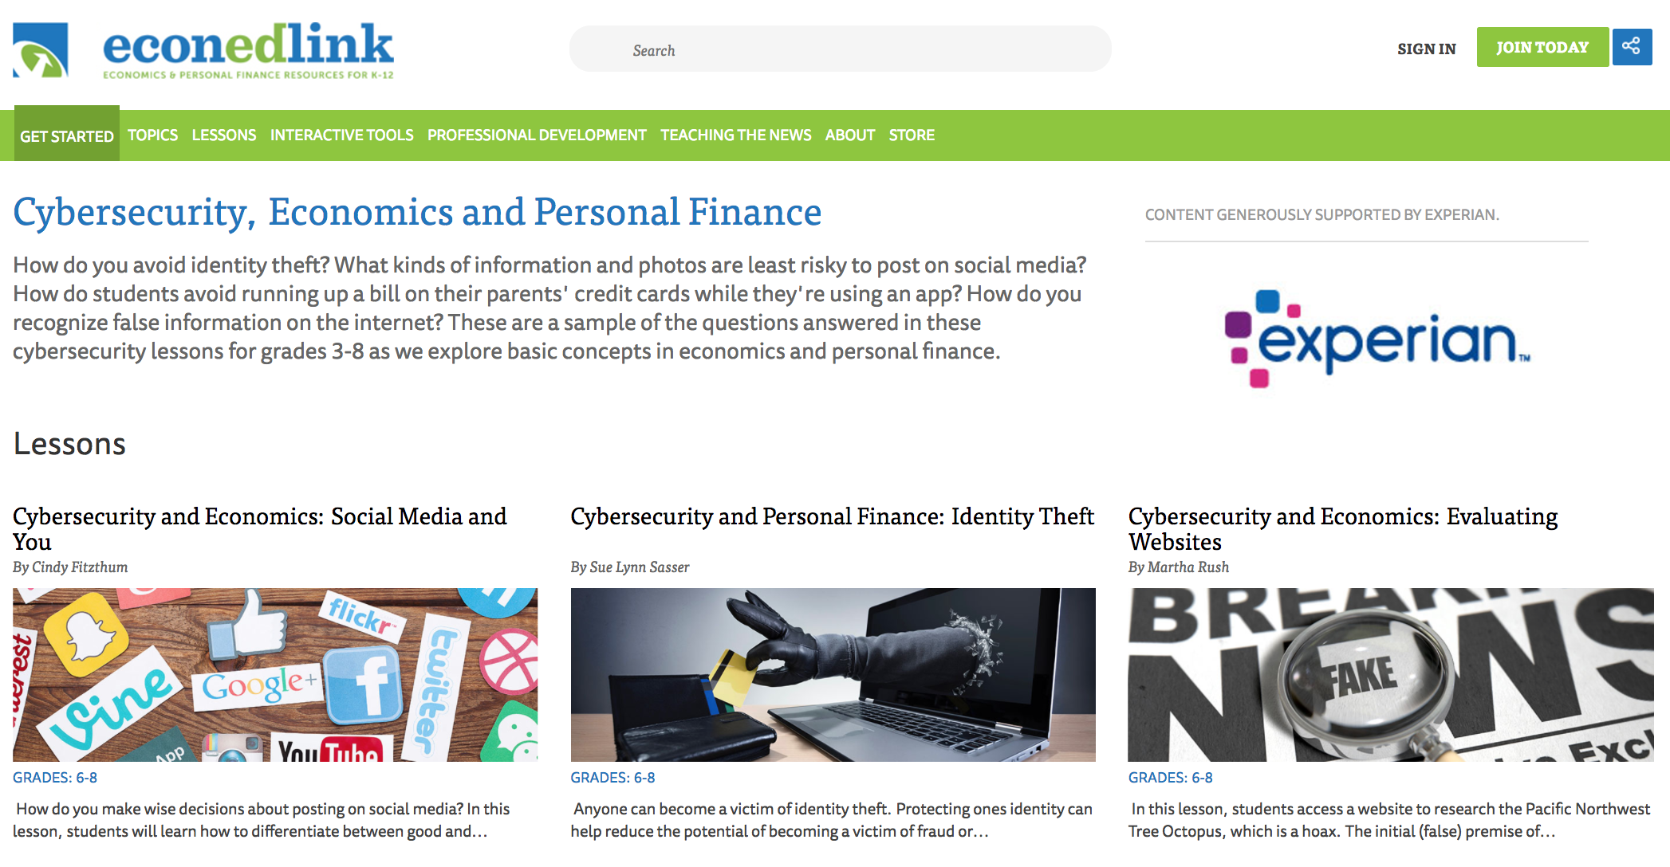
Cybersecurity Lessons

Slide 8
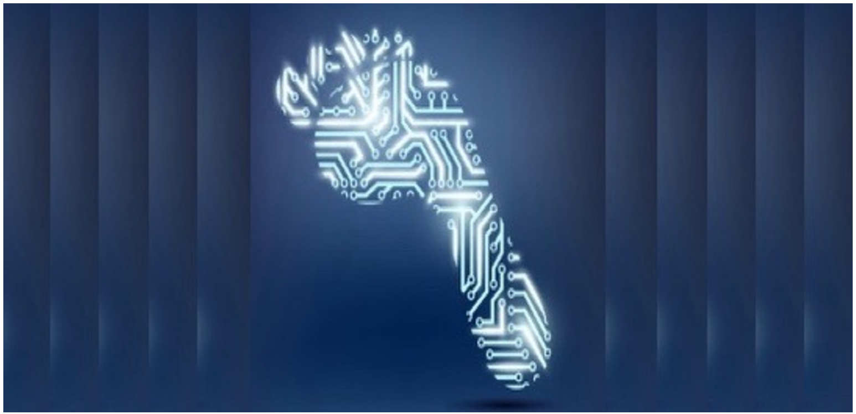
Cybersecurity and Personal Finance:
Digital Footprints

Slide 9

Handout 4: Footprint

Slide 10
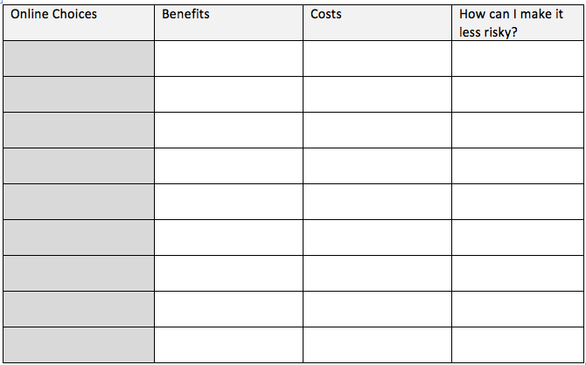
Handout 6: Digital Footprint Analysis

Slide 11
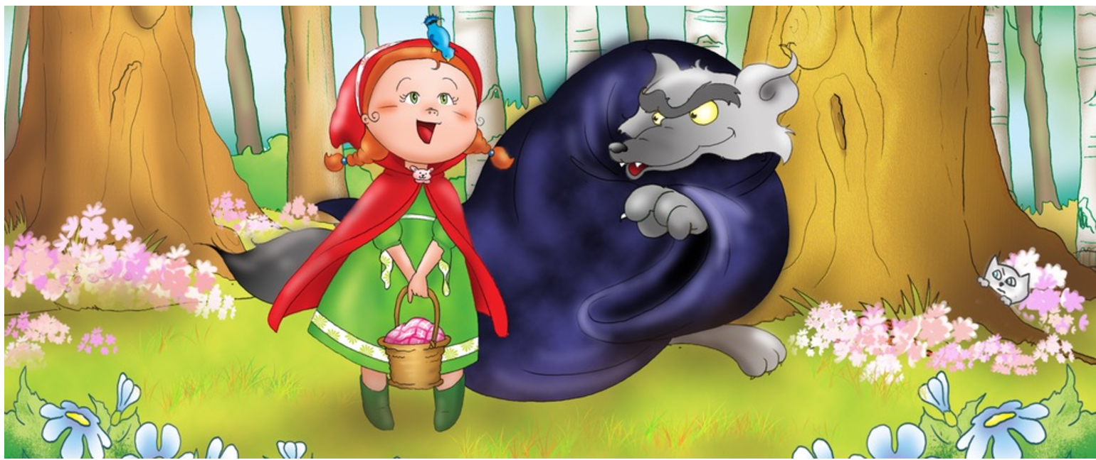
Cybersecurity and Personal Finance:
RED and the Cyberwolf

Slide 12
Visual 1: Online Profiles
Profile 1
Profile 2
I am a ten-year old boy. I play soccer and tennis. I like to meet people online and play games. My favorite food is bacon.
I am a girl and I just turned nine. My favorite thing to do is play Minecraft. On weekends, I visit my grandma and aunt and bring them cookies.
How would these people look, based on their profiles?

Slide 13
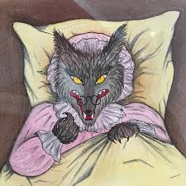
Visual 2: Picture of Wolf
How different is this from how you saw people based on the online profiles?
When you are online, you never know whether people are telling the truth about their identities.
Just like the wolf pretended to be Little Red’s grandma, adults can pretend to be a child online.

Slide 14
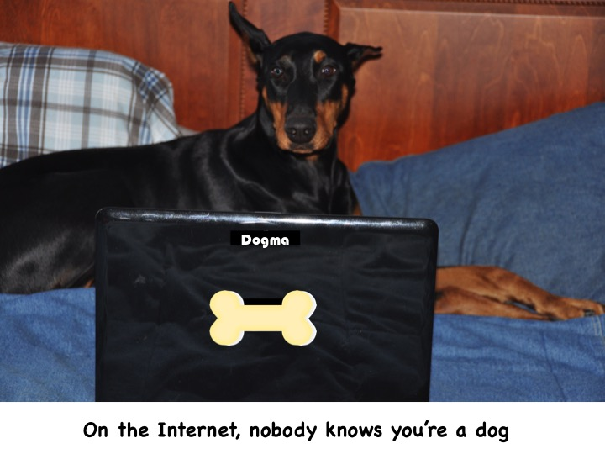
Handout 2: Part 1
On the Internet, Nobody Knows You Are a Dog (Lexile 930)
“On the Internet, nobody knows you are a dog” is a popular funny meme that has been copied and spread across the web. It started as a cartoon created by Peter Steiner and published in The New Yorker on July 5, 1993. In the cartoon, a dog is sitting on a chair in front of a computer. He is telling another dog “on the Internet, nobody knows you are a dog.” What do you think he means?

Slide 15
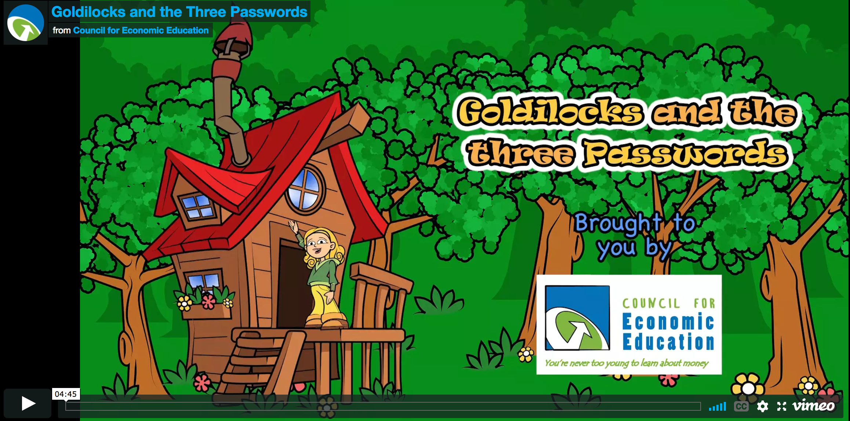
Cybersecurity and Economics:
Goldi and the Three Passwords

Slide 16
Handout 2:
Baby Bear’s Suggestions for Just-Right Passwords
Password Do’s
Password Don’ts
At least eight characters
Use upper- and lower-case letters
Use numbers and symbols (&%$#)
Change passwords regularly
Should only be shared with a parent or guardian in case you forget it.
Don’t use your email address
Don’t use private information
Should not be the same on all sites
Don’t share with friends

Slide 17
Making Stronger Passwords
Adding new values can make your password much stronger. See how long the time to guess Goldi’s password can be just by adding more characters, or numbers:
Goldi – 26 Seconds
GoldiPlays – 300 Years
GoldiPlays! – 6,000 years
GoldiPlays!Hockey5 – Over a Million Years

Slide 18
Handout 3:
Instructions for a Public Service Announcement
You are a consulting company providing information to others about the importance of creating good passwords.
  Who are you? (Use a name that reflects what you are doing) _______________________________________________
  We are here to tell you about: _______________________________________________
  Why should you create strong passwords? (Discuss: costs, benefits, and risks in your statement) ____________________________________________________________________________________________________________
  Here are some tips for creating good passwords: (each student provides one tip)
    ____________________________________
    ____________________________________
  So remember: (end with a short slogan or saying) _________________________________________________.

Slide 19
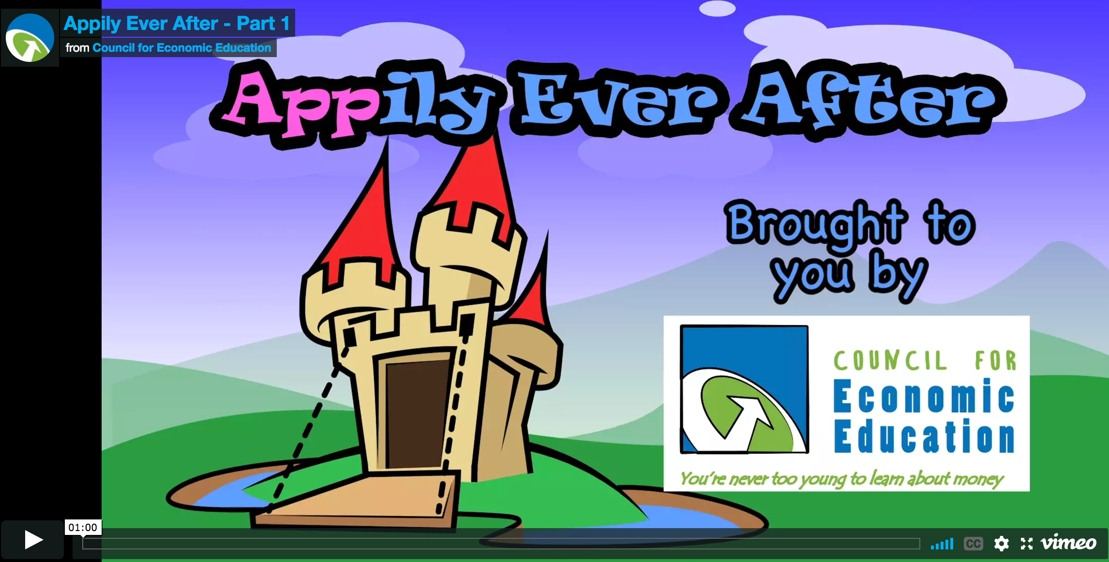
Cybersecurity and Personal Finance:
Appily Ever After

Slide 20
Handout 1: Ana’s Spending
Ana wanted to download some apps
Her mom said she could download free apps
The app said she could have it ad-free for $5.00
Her mom entered her credit card
She paid $10.00 for the second app to be ad-free
Ana downloaded a free Princess Ninja app
It said she could buy 5 new dresses for $1.00 each
Then it said “get a new world for $10.00”
Paid $10.00 for tokens to buy new outfits and equipment
Paid $5.00 for faster time
New worlds cost $5.00 each – she bought 2
New characters cost $2.00 each – she bought 5
Total = ____
She downloaded 5 songs from the game at $2.00 each
New cars cost $5.00 – she bought 4
She downloaded a princess race car game

Slide 21
Handout 2: Problem/Solution
Problem: What was Ana’s problem?
Solution: What advice did Jamal give Ana?
Draw what happened:
Write about it:
_________________________________________________________________________________
Draw what happened:
Write about it:
_________________________________________________________________________________

Slide 22
Handout 3: In-app Purchases
Ana received a $25.00 gift card for app purchases. These are the apps she likes. Make some recommendations to Ana that you think are responsible.
Pop Star Singing | Build a Roller Coaster | Superhero Fashion Show
$5.00 to make ad-free | $5.00 to make ad-free | $10.00 to make ad-free
$1.00 per song for kid’s songs | $5.00 for each new roller coaster kit | $1.00 for each new outfit
$2.00 per song for current popular songs | $10.00 for a new theme park | $1.00 for each new background
$1.00 per each new background image | $10.00 for faster time | $2.00 for each new superhero

Slide 23

Cybersecurity and Personal Finance:
Social Media and You

Slide 24
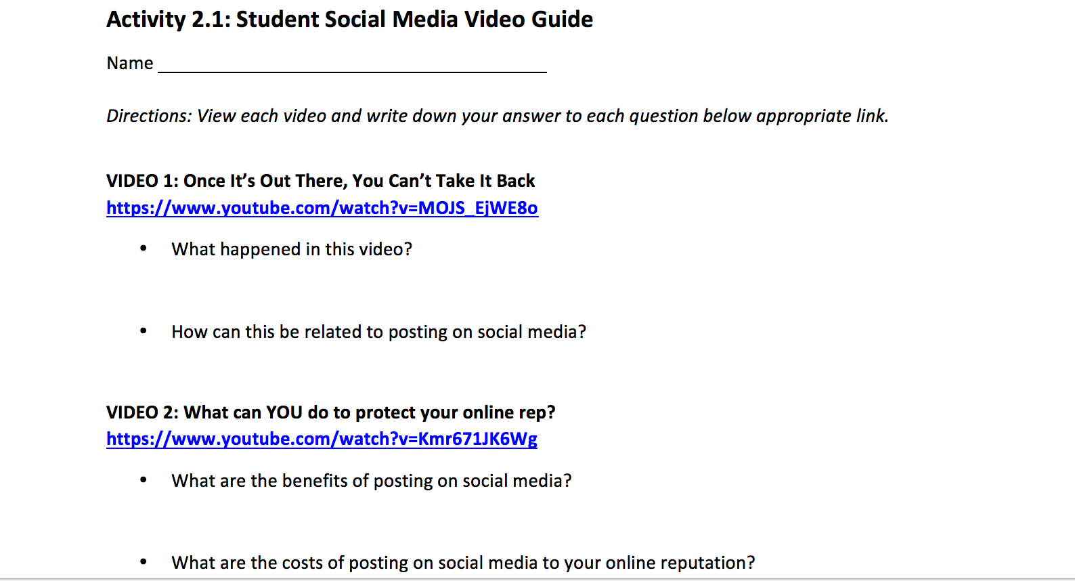
Cybersecurity and Personal Finance:
Social Media and You

Slide 25
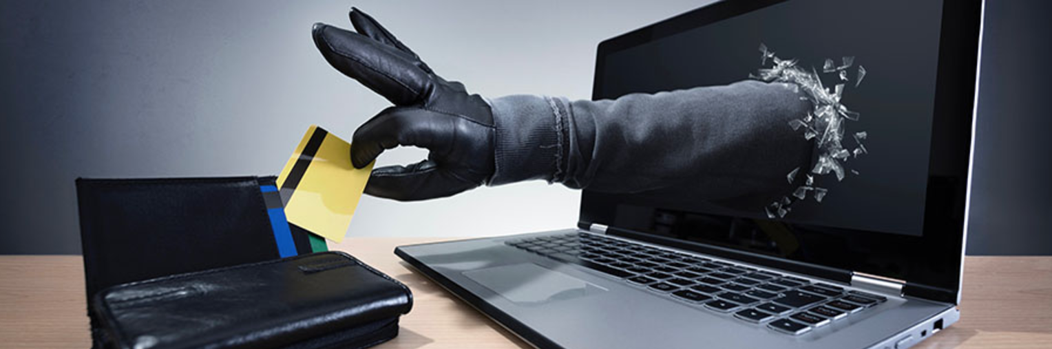
Cybersecurity and Personal Finance:
Identity Theft

Slide 26
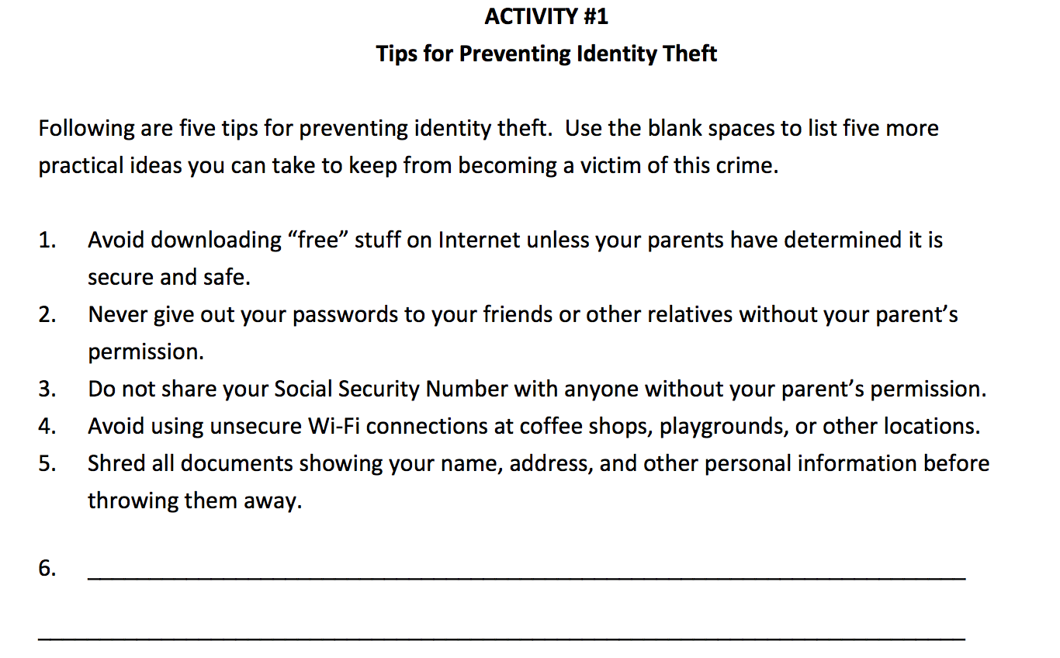
Cybersecurity and Personal Finance:
Identity Theft

Slide 27
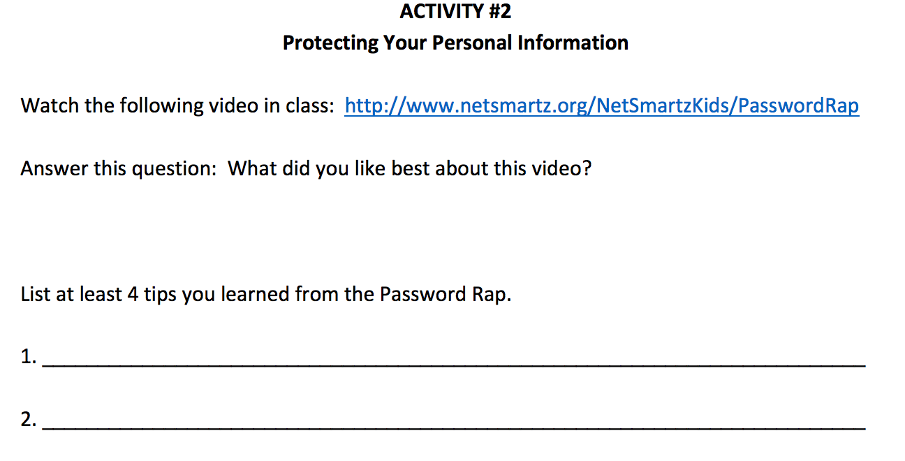
Cybersecurity and Personal Finance:
Identity Theft

Slide 28

Cybersecurity and Economics:
Identifying Websites

Slide 29
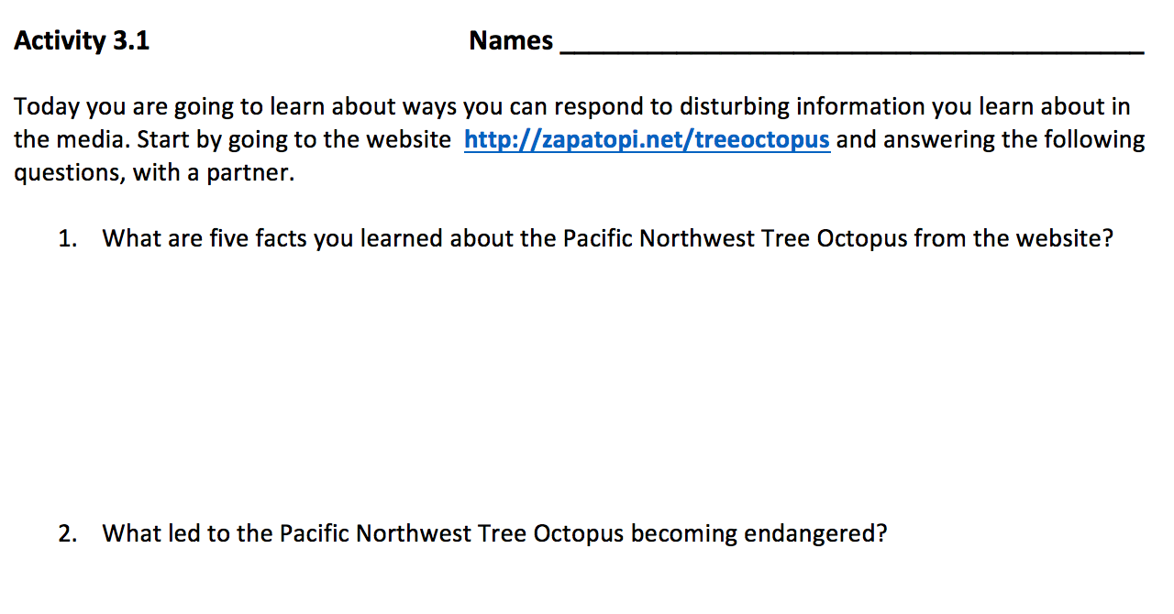
Cybersecurity and Economics:
Identifying Websites

Slide 30
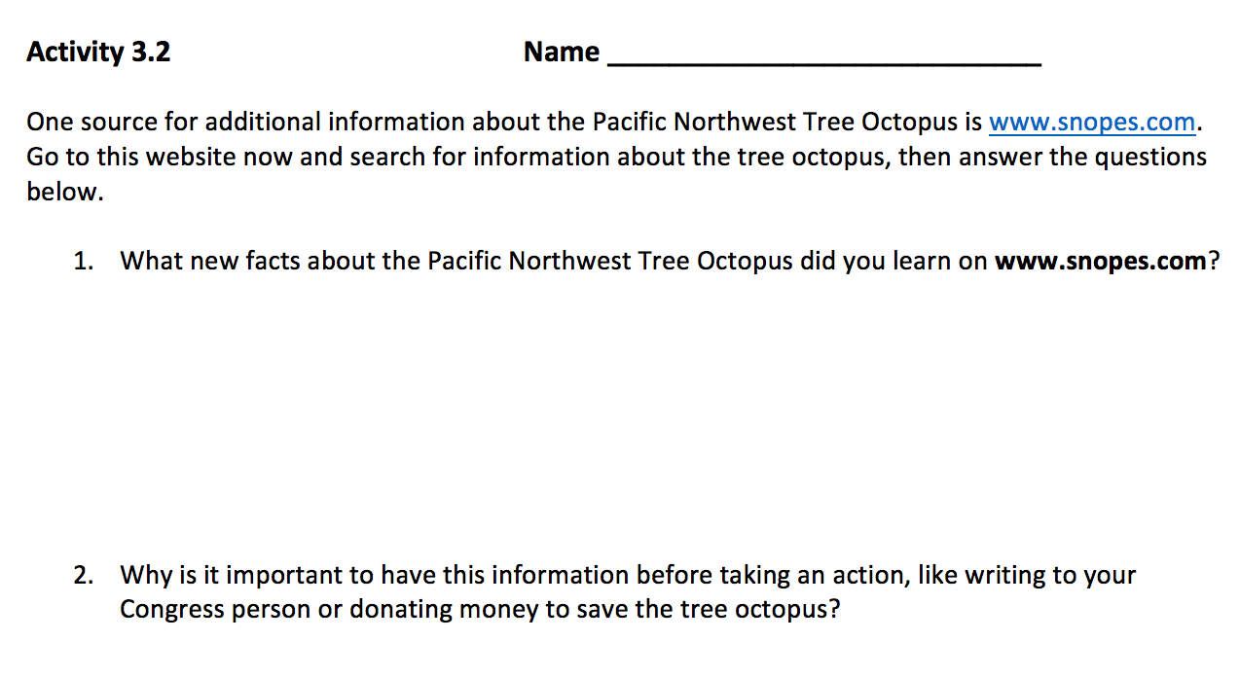
Cybersecurity and Economics:
Identifying Websites

Slide 31
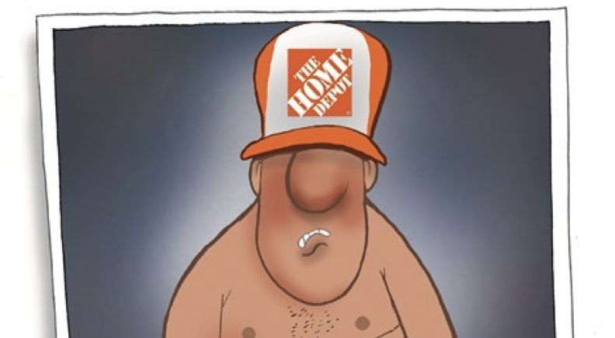
How Can You Protect Yourself Online?

Slide 32
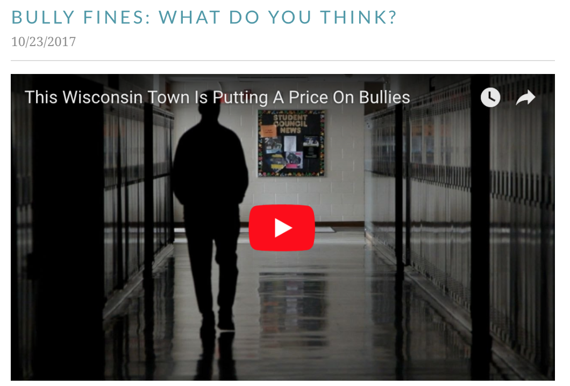
http://floridafinancialliteracy.weebly.com/blog/bully-fines-what-do-you-think

Slide 33
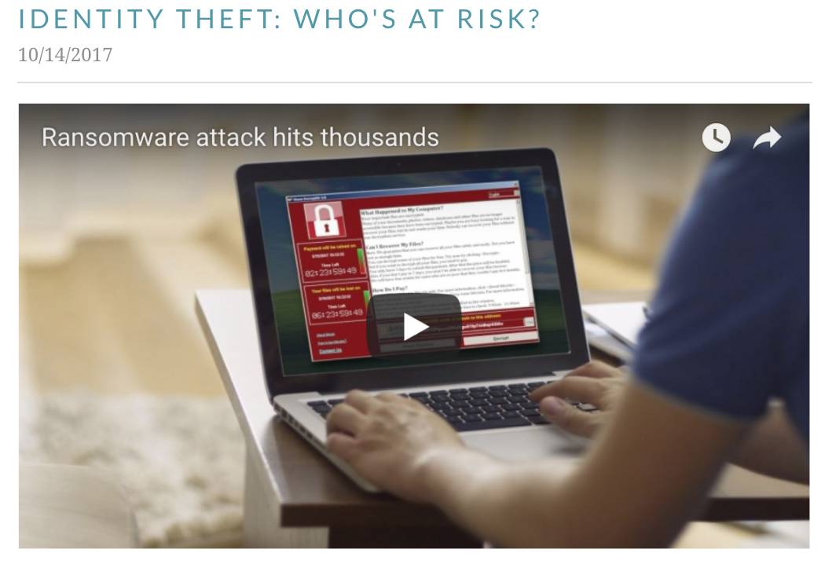
http://floridafinancialliteracy.weebly.com/blog/identity-theft-whos-at-risk

Slide 34
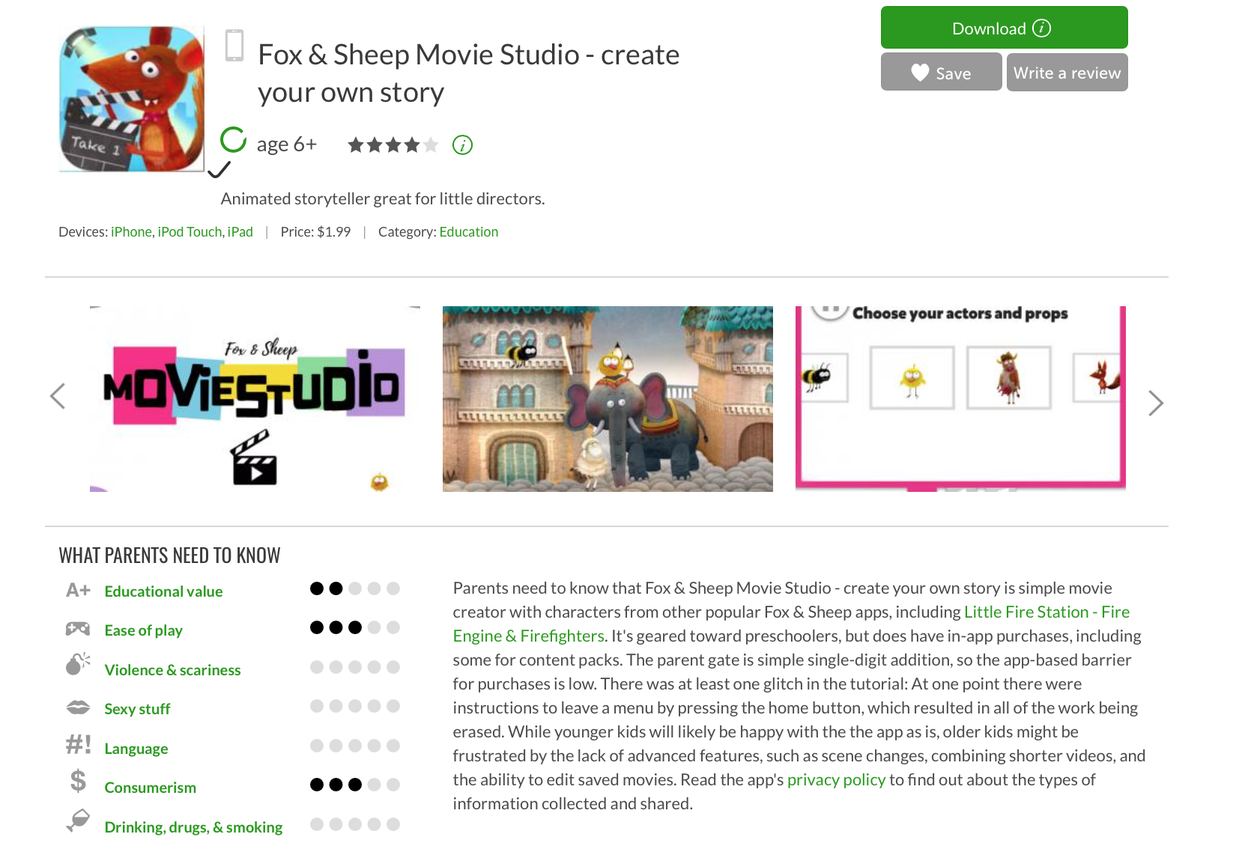
https://www.commonsensemedia.org/app-reviews

Slide 35
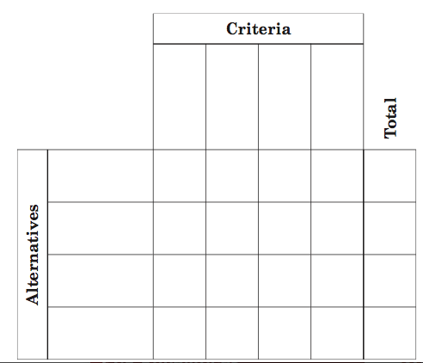
PACED Decision Making Model
P – Purpose: Decision or Problem?
A – Alternatives or choices
C – Criteria to evaluate the alternatives
E – Evaluate the alternatives
D –Decision – Evidence-based decisions
I chose __________because: _________________________________________

Slide 36
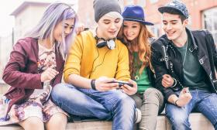
Appily Ever After: Common Sense Media
https://www.commonsensemedia.org/blog/16-apps-and-websites-kids-are-heading-to-after-facebook

