Slide 1
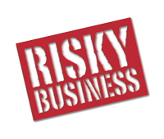
The USF Stavros Center Presents:
Deborah Kozdras dkozdras@usf.edu
USF Stavros Center http://stavros.coedu.usf.edu
http://tinyurl.com/USFStavrosRiskyBusiness
Workshop funded by:

Slide 2
Pennies from . . .
http://www.criticalcommons.org/Members/oroark/clips/pennies-from-heaven-frank-sinatra/view

Slide 3
Life is Risky Business
Part 1
Part 2
Describe the term “risk” as you would if you were trying to explain it to a friend.
Brainstorm a list of words you associate with the idea of risk and list them.
https://www.frbatlanta.org/education/lessons/bell-ringer/life-is-risky-business

Slide 4
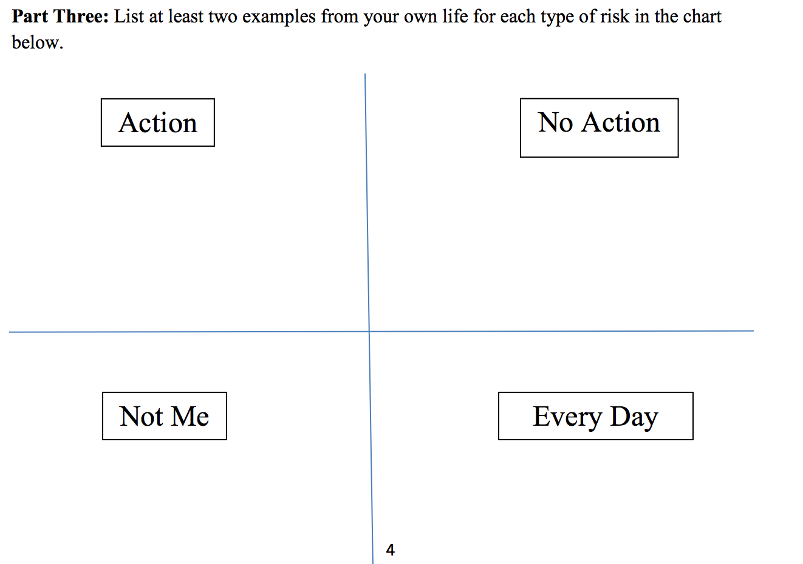
Part 4: Suggest strategies you would use to manage the risk on your chart

Slide 5
Should I wear a helmet or not when I ride a bicycle?
Should I stay or should I go? What should you do if a hurricane is coming?
Should I spend my entire allowance or should I save it for emergencies?
National Financial Literacy Standards

Slide 6
Economic Decision Making
Decision
Define the purpose
List two choices
Evaluate the choices
Make a decision
Choice 1
Good Things ☺
Bad Things ☹
Choice 2
Good Things ☺
Bad Things ☹
Purpose

Slide 7
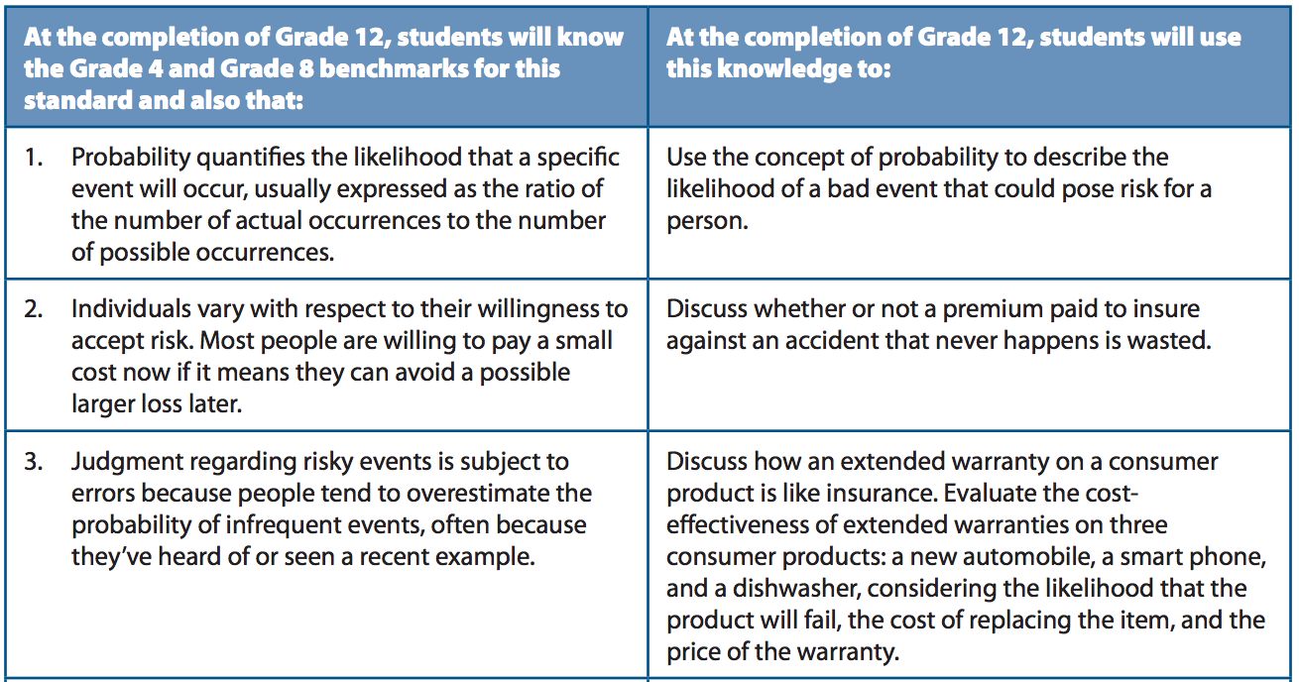

Slide 8
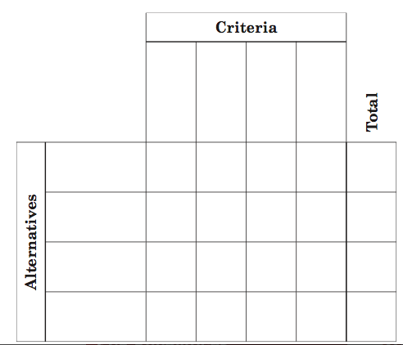
PACED Decision Making Model
P – Purpose: Decision or Problem?
A – Alternatives or choices
C – Criteria to evaluate the alternatives
E – Evaluate the alternatives
D –Decision – Evidence-based decisions
I chose __________because: _________________________________________

Slide 9
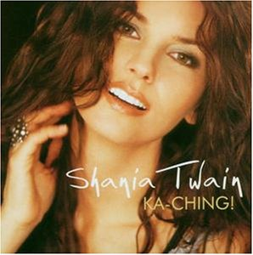
Ka-Ching
http://www.criticalcommons.org/Members/oroark/clips/shaniatwainkaching.mp4/view

Slide 10
Payday Loans
http://floridafinancialliteracy.weebly.com/blog/payday-loans

Slide 11
Shady Investors
http://floridafinancialliteracy.weebly.com/blog/beware-of-shady-investors

Slide 12
http://floridafinancialliteracy.weebly.com/blog/facts-on-equifax

Slide 13
Student Loans: Stressed Out? Wake Up You Need to Make Money!
http://floridafinancialliteracy.weebly.com/blog/repay-student-loans

Slide 14
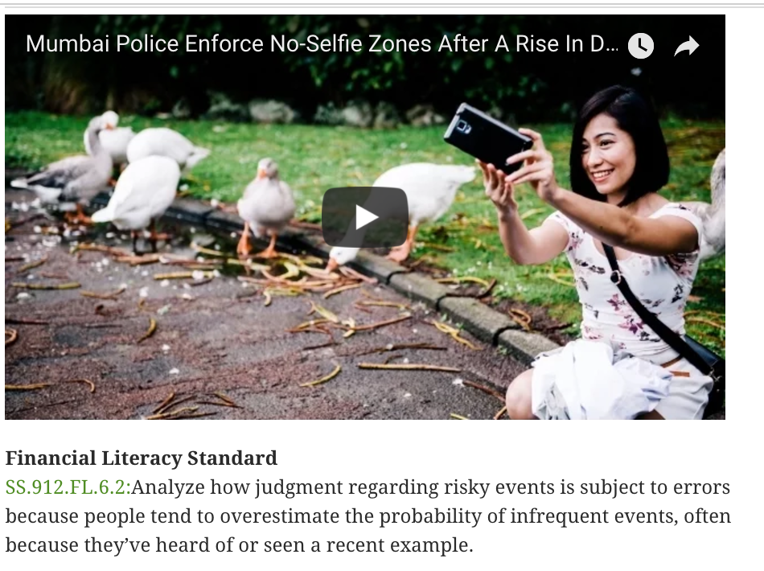
No Selfie Zone
http://floridafinancialliteracy.weebly.com/blog/why-did-mumbai-police-inflict-a-no-selfie-zone

Slide 15
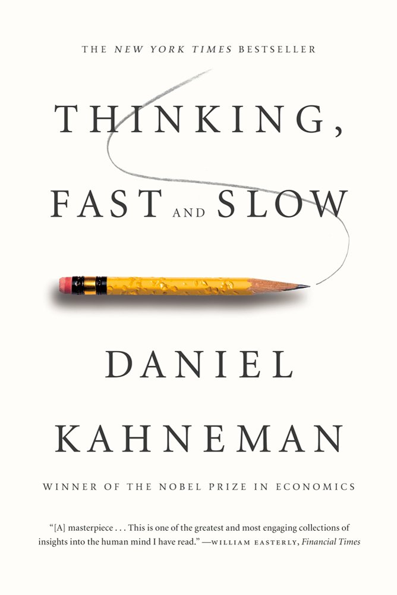
Behavioral Economics: Thinking Fast and Slow
https://www.youtube.com/watch?v=KyM3d4gQGhM

Slide 16
http://floridafinancialliteracy.weebly.com/blog

Slide 17
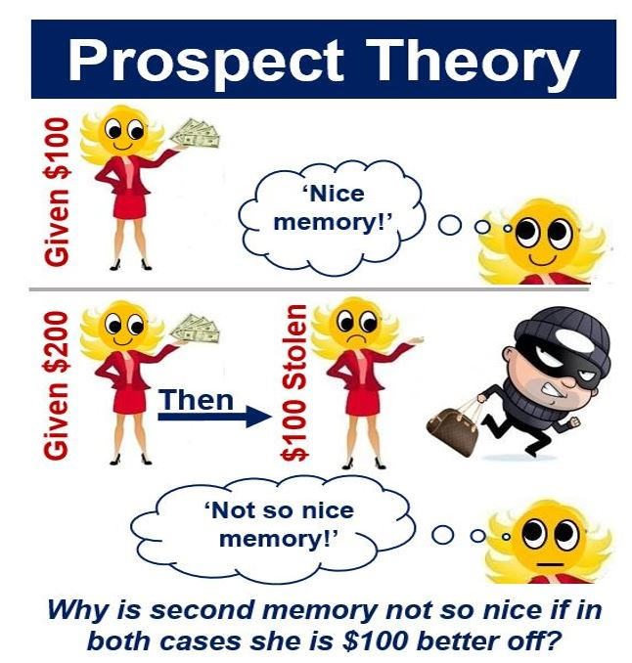
Risks!
-according to loss-aversion theory, we give an unpleasant event more negative weight than the equivalent positive weight for a positive event.
-Losing $100 has more negative weight than the positive weight we get from receiving $100.
-This irrational or illogical way of thinking is what Kahneman and Tversky observed.
http://marketbusinessnews.com/financial-glossary/prospect-theory-definition-meaning/
Notes:
instead, their decisions are parsed for clues about true preferences and biases.

Slide 18
Prospect Theory: An Analysis of Decision under Risk (1979) Kahneman and Tversky
“Choices among risky prospects exhibit several pervasive effects that are inconsistent with the basic tenets of utility theory.”
Certainty Effect: people underweight outcomes that are merely probable in comparison with outcomes that are obtained with certainty.
Risk Aversion: in choices involving sure gains and to risk seeking in choices involving sure losses.”
In an Abstract preceding their paper,

Slide 19
Notes:
Prospect theory is very useful for explaining people’s apparent irrational behavior. Kahneman and Tversky found that losses had more emotional impact than the equivalent amount of gain for people.

Slide 20
Do this with money
1. You are holding $1,000 in your hand and you have to choose either
Option A: There is a 50% probability of gaining $1,000 and a 50% probability of gaining zero dollars.
Option B: There is a 100% probability – a certainty – of gaining $500.
2. You are holding $2,000 in your hand and you have to choose either
Option A: There is a 50% probability of losing $1,000, and a 50% probability of losing nothing.
Option B: There is a 100% probability – a certainty – of losing $500.
Notes:
The vast majority of the participants chose Option B for question 1, and Option A for question 2. It seems that people are willing to accept a reasonable level of gain – if they think there is a reasonable probability of gaining more – but will engage in risk-seeking behaviors where they can minimize their losses – our losses are weighted more heavily than gains of equivalent amounts.

Slide 22
EconEdLink
http://www.econedlink.org/teacher-lesson/1356/Behavioral-Economics-Lesson-Three-Loss-Aversion-Endowment-Effects-Default-Bias

Slide 23
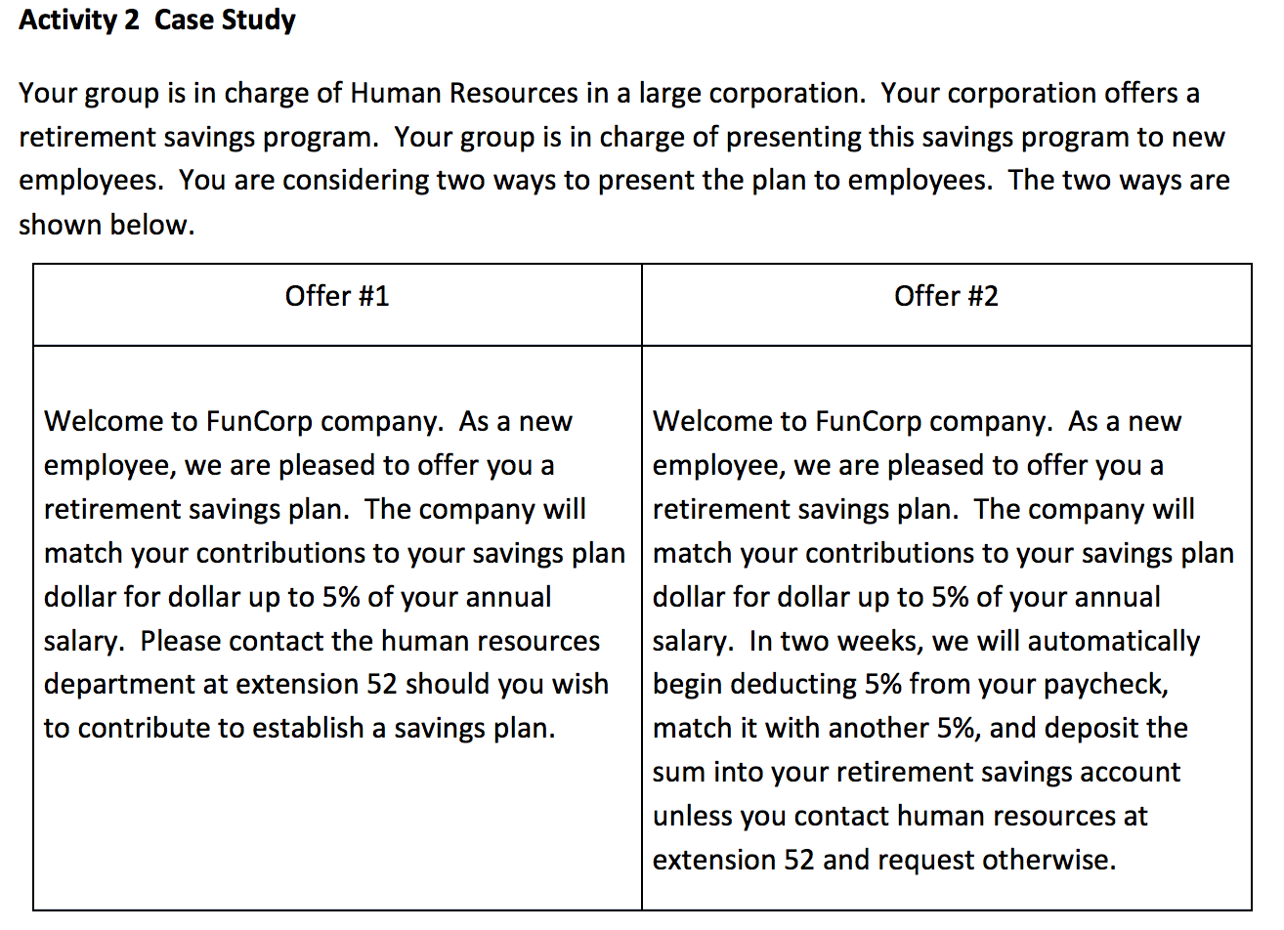

Slide 24
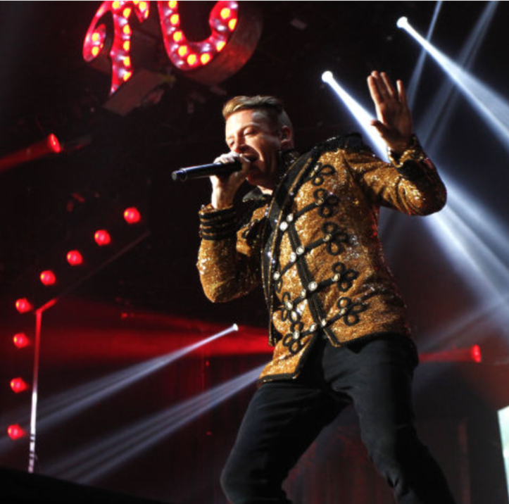
Thrift Shop Decision-making
What can Macklemore teach us about Financial Literacy and managing risks?
What were the costs and benefits of Jeremy’s decision to buy the shoes at the thrift shop?
http://floridafinancialliteracy.weebly.com/blog/money-tips-from-macklemore-thrift
http://modelelicitingactivities.weebly.com/sneakonomics.html

